Slide 1


WELCOME TO OUR
YEAR 7 INFORMATION EVENING
Mr Griffiths
Vice Principal in charge of Curriculum
Mrs Hachipuka
Head of Beech House/Assistant Principal

Slide 2
THE JOURNEY SO FAR
Your child may have….…
Found their feet and way around College.
Made new friends.
Taken part in an extra curricular activity.
Taken part in an Inter House competition.
Been a student voice - student Council, Twos, Mental Health Ambassador…
Sung in the school choir.
Completed Home Learning and progressed in lessons.
Managed their behaviour.
Gained confidence.
Developed relationship with teachers and tutor and Head of House.
Understood our College systems.
Had some bumps along the way and overcome them.
Still overcoming bumps.

Slide 3
OPPORTUNITIES IN YEAR 7 AND 8
Student Voice – Mental Health Ambassadors, Student Council, TWOs.
Inter House events – Sport, Science and English competitions, Maths Quizes …
Enrichment Week – chance to make new friends, try something new.
Join a club – vast extra curricular programme.
Represent the school in a sports team, choir, school band…
Develop knowledge in subject areas.

Slide 4
ATTENDANCE AND BEHAVIOUR
Mr Griffiths

Slide 5
“You're going to die in about 80 years
so enjoy yourself,
don't waste one second,
and don’t spoil it for the rest of us.”

Slide 6
5 September 2018
2015
2020
2025
2030
2035
2040
2045
2050
2055
2060
2065
2070
2075
2080
2085
2090
2095
2100

Slide 7
24 August 2023
2015
2020
2025
2030
2035
2040
2045
2050
2055
2060
2065
2070
2075
2080
2085
2090
2095
2100

Slide 8
22 August 2025
2015
2020
2025
2030
2035
2040
2045
2050
2055
2060
2065
2070
2075
2080
2085
2090
2095
2100

Slide 9
June 2028
2015
2020
2025
2030
2035
2040
2045
2050
2055
2060
2065
2070
2075
2080
2085
2090
2095
2100

Slide 10
2015
2020
2025
2030
2035
2040
2045
2050
2055
2060
2065
2070
2075
2080
2085
2090
2095
2100
Somewhere around 2085-2086
Notes:
Male born 2005-2007, 78.8 years

Slide 11
2015
2020
2025
2030
2035
2040
2045
2050
2055
2060
2065
2070
2075
2080
2085
2090
2095
2100
Somewhere around 2089-2090
Notes:
Female born 2005-2007, 84.5 years

Slide 12
2015
2020
2025
2030
2035
2040
2045
2050
2055
2060
2065
2070
2075
2080
2085
2090
2095
2100
Notes:
There’s a big gap… And it is all of this stuff before that makes the gap easier, happier, more fulfilling

Slide 13
Notes:
In year groups.

Slide 14
Notes:
But Y8, you’ve already lost this; time you’ll never get back.

Slide 15
Notes:
And then don’t forget during Y11 your exams start in May, so between then and July you’re not getting taught any more.

Slide 16
Notes:
So really, this is how long you’ve got left from Y8.

Slide 17
Notes:
But if we assume you lose 5 minutes every lesson between now and your exams look what happens. You’re actually going to lose about 65 teaching days.

Slide 18
Notes:
And if we assume that you have 95% attendance, i.e. about 9 days a year…

Slide 19
Notes:
So with 95% attendance and wasting 5 minutes every lesson this is really how much time you have left, about 68% of your whole time in secondary school.

Slide 21
Notes:
But you might have 90% attendance, one day off every two weeks. Look what happens now.

Slide 22
Notes:
But you might have 90% attendance, one day off every two weeks. Look what happens now.

Slide 23
Notes:
Or even worse, 80% attendance. Now you have almost half of your secondary time left at school.

Slide 25
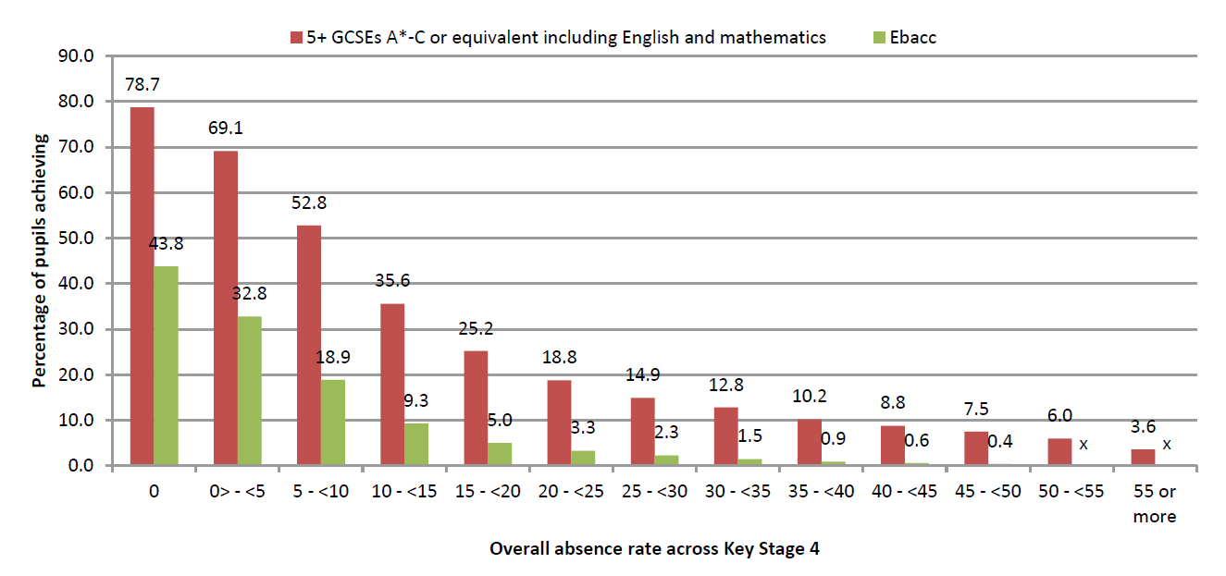
Notes:
As your absence increases, the chances of you obtaining good GCSE decreases.

Slide 26
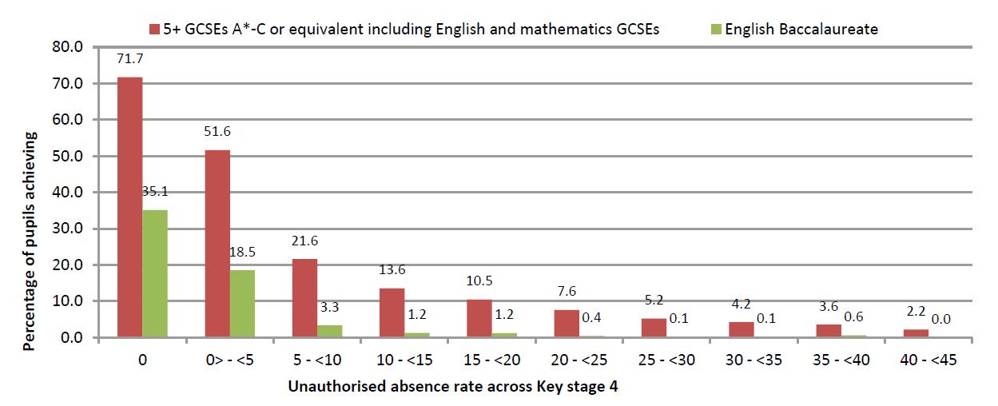

Slide 27
4+
Notes:
So if we want our financial futures to be better, we need the highest qualifications we can get, but the chance of us getting these qualifications is dependent on our attendance, our time in school and, of course, how we spend our time in school.

Slide 28
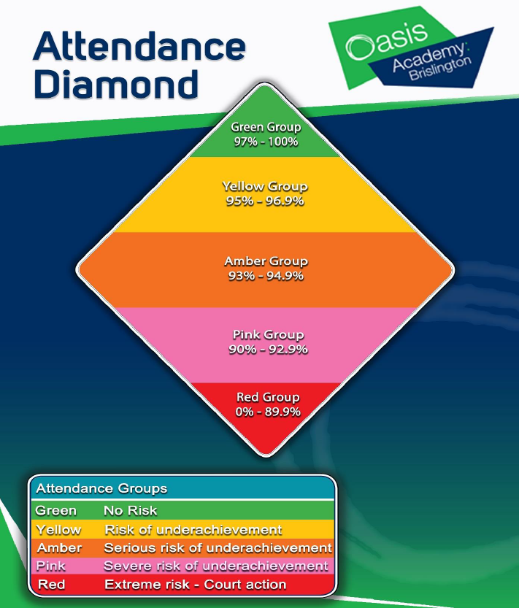
Notes:
So this is what we’re going to do…
[Show anonymised tracker]

Slide 29
Lessons are for learning
and all students have the right to learn and be taught
in disruption-free classrooms.

Slide 30
Aims of a new behaviour approach at Okehampton College
To celebrate students who succeed and progress.
To develop a kind, thriving environment
where students learn and teachers teach well.
Ready to Learn is a whole school system
which all staff will use in a fair and consistent way.
To eliminate disruptive behaviour.
To ensure staff and students are 100% clear
on what is acceptable behaviour.
To encourage students to take responsibility for their own actions.
To enable teachers to deliver engaging and stimulating lessons
all of the time.
Notes:
Raising attainment plans

Slide 31
GROWTH MINDSET
Growth mindset is the belief that one's intelligence can be grown or developed with persistence, effort, and a focus on learning. Individuals with a growth mindset believe they are capable of learning nearly anything if they work hard and accept failures and challenges as opportunities to grow.
It is about not being able to do something YET.
Eg. You may not be able to answer a GCSE English question now but everything you do, practise and work towards brings you one step closer.
In year 7 there is the temptation to think that you can't do the work of year 10 or 11 students and so they shouldn't or won’t. But this mindset isn't the best one to have.
Just because they can’t do it yet, doesn't mean that they should not try.

Slide 32
ENCOURAGING INDEPENDENT LEARNING
There is a lot of research to say that year 8 is the 'lost‘ year in education because it lacks a focus. Year 7 is all about transition. Year 9 focuses on options and year 10 and 11 on GCSEs therefore year 8 can see students cruise!
However, encouraging students to use year 8 wisely and constructively will allow students to progress at a faster rate. This positive mindset will help them reach better goals.
The earlier students can develop these skills the better.
Don't wait for year 10 or 11 to learn and develop how to be more independent.
Develop Responsibility and self discipline and not rely on teachers or parents to remind you or tell you do to things.

Slide 33
10 Good Habits to develop
Independent Learning
Do something for 10 minutes every day to better my learning or reading?
Buy a diary or start using an electronic diary to make a note of key dates and assessments to help plan ahead - not just with school but life outside of school too.
Find 3 revision websites and visit them once a week.
Read/be read to every day.
Believe in Yourself/in your child, give praise – focus on the positive.
Ask What They Need.
Encourage Progress, Process and Effort not just achievement and attainment.
Create Opportunities for Independence.
Provide a Learning Space.
Use of language and questioning.

Slide 34
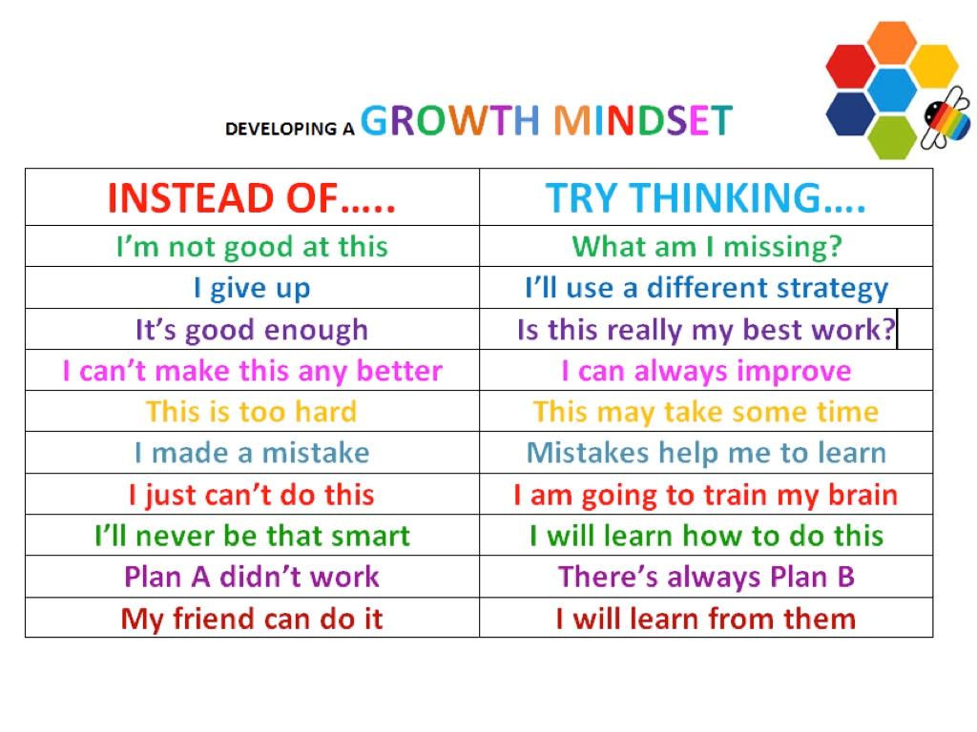

Slide 35
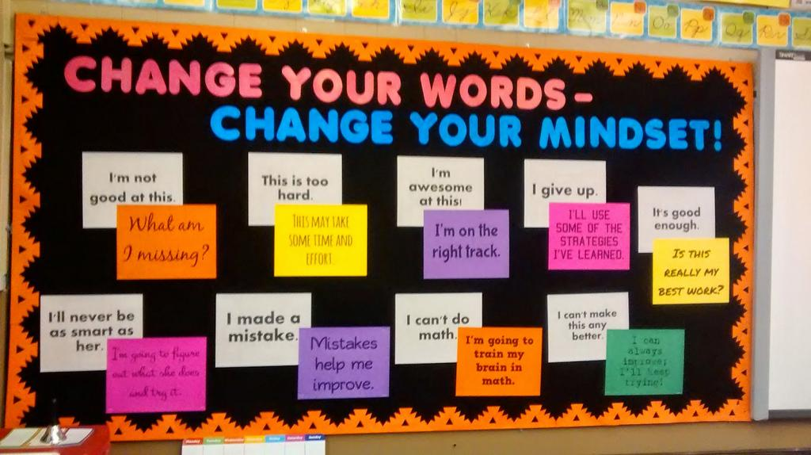
Some schools/parents have turned this into displays…

Slide 36
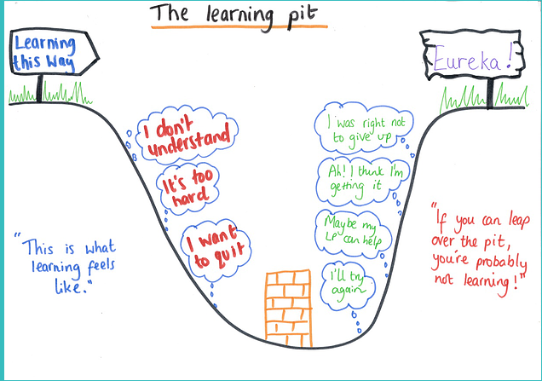

Slide 37
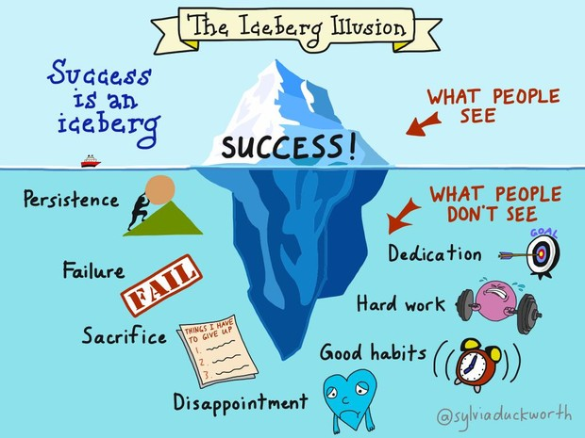

Slide 38
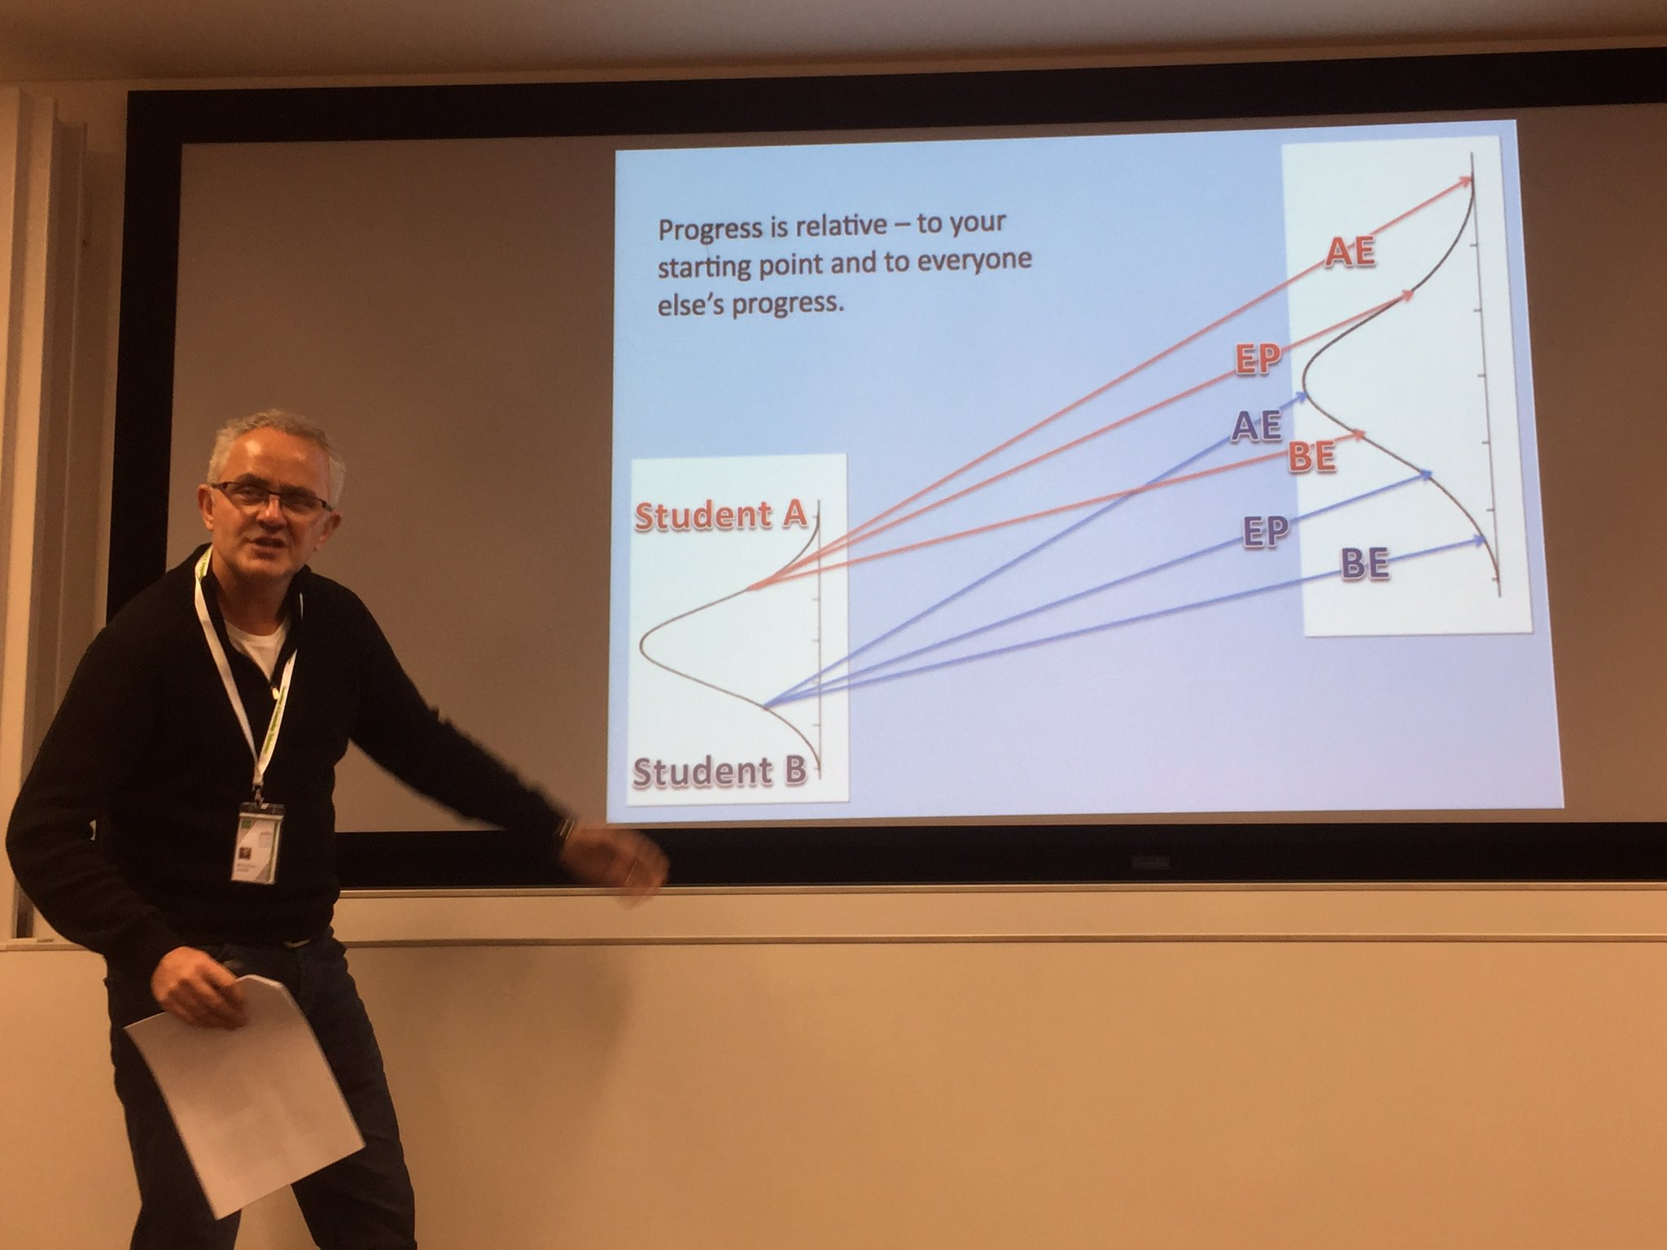
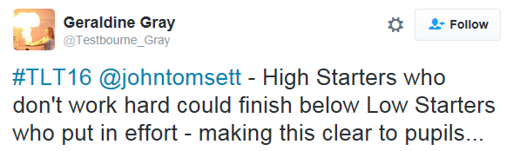

Slide 39
Thank you for listening.
ANY QUESTIONS?

