Slide 1
Welcome to Geography
Mrs. Doxford

Slide 2
What is Geography?
Learning about the earth – our home.

Slide 3
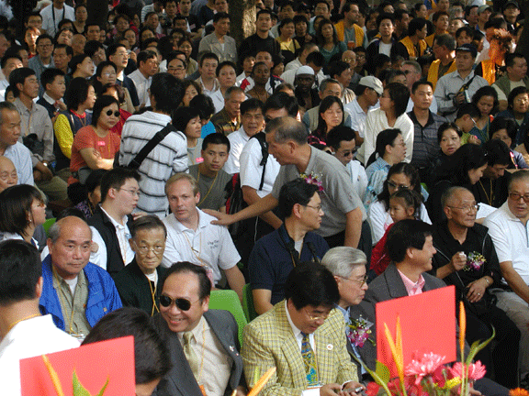
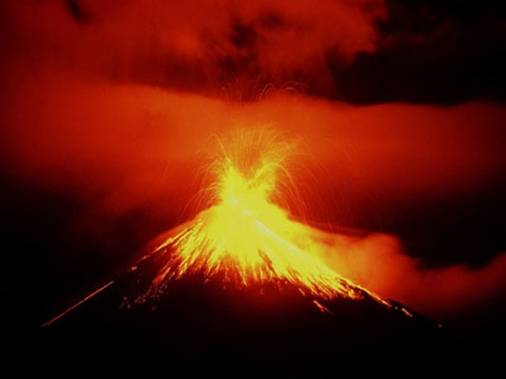
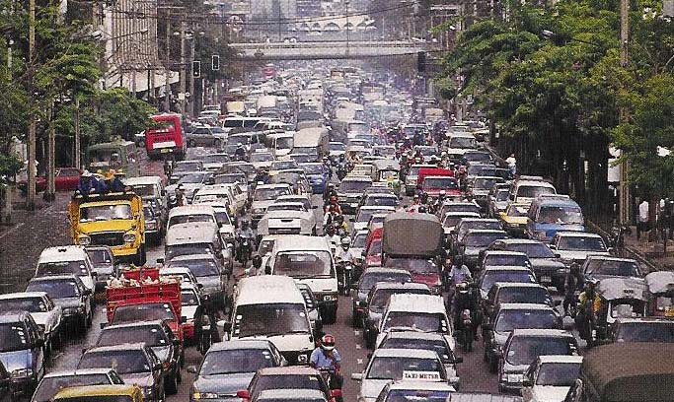
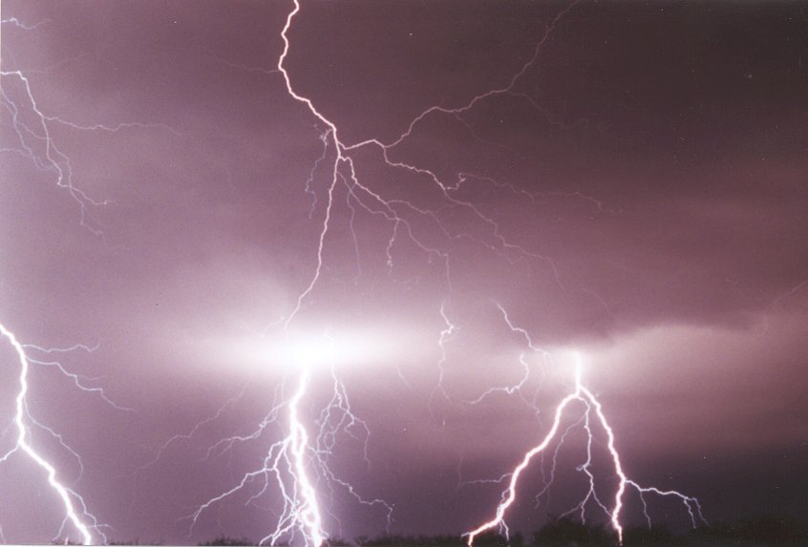
Physical Geography
Human Geography

Slide 4
Geography is about everything on our planet, from the planet itself to you!

Slide 5
So, let’s start by learning more about you!
Notes:
Find someone who starter

Slide 6
In this exercise,
you need to imagine
you are an
alien invader…
Some of you,
no doubt,
will find this
very easy…

Slide 7
Your Title:
The Physical and Human Geography of the Earth
Split your page into two columns with these headings:
Physical Geography
Human Geography
Okehampton College has presentation expectations!
Use a ruler!

Slide 8
You are now about to see some incredible facts
about the planet you live on.
As you read them, try to keep notes on the
most important facts.
Try to decide whether the facts that you hear are
Physical Geography or Human Geography.
You do not need to write everything down!
Try to keep enough notes that you will
remember the ideas in your report later!

Slide 9
Water in the form of the oceans,
covers approximately 70% of the earth's surface, with land the remaining 30%.

Slide 10
60% of the world does not have the internet!

Slide 11
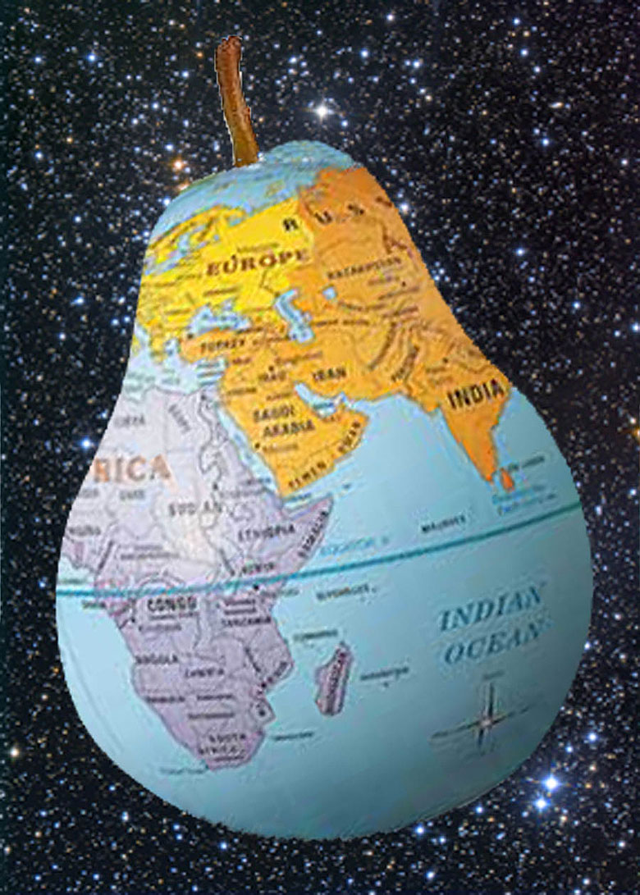
EARTH is not a perfect sphere but is slightly pear shaped.

Slide 12
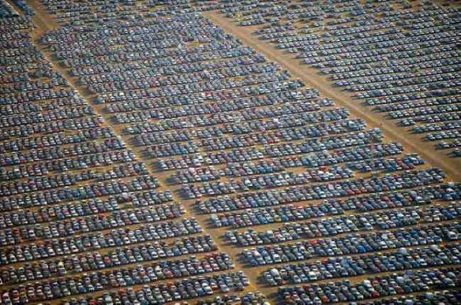
There are about 1.2 billion vehicles in the world today.
In 1950, there were 50 million.

Slide 13
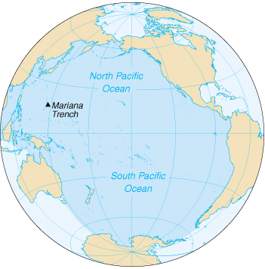
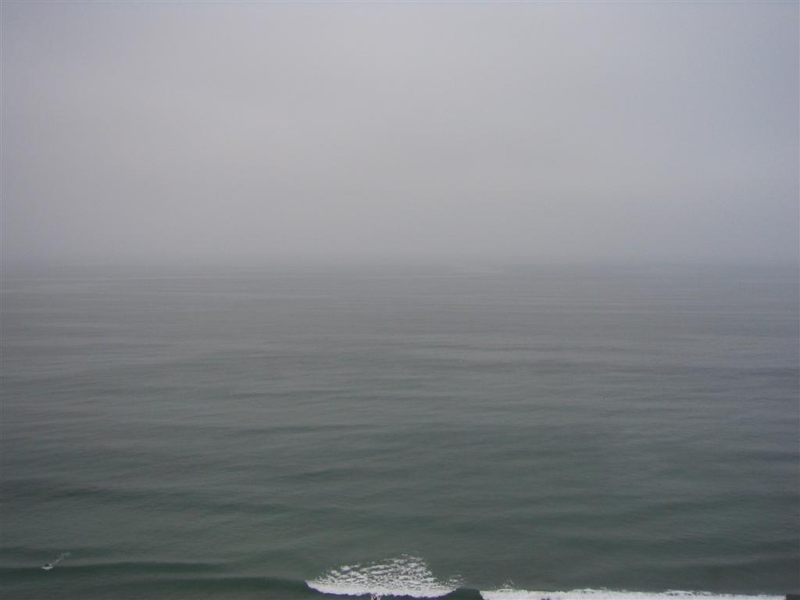
The Pacific Ocean
is three times bigger than Asia,
the biggest continent on Earth.
It covers nearly one-third of the Earth's surface.

Slide 14
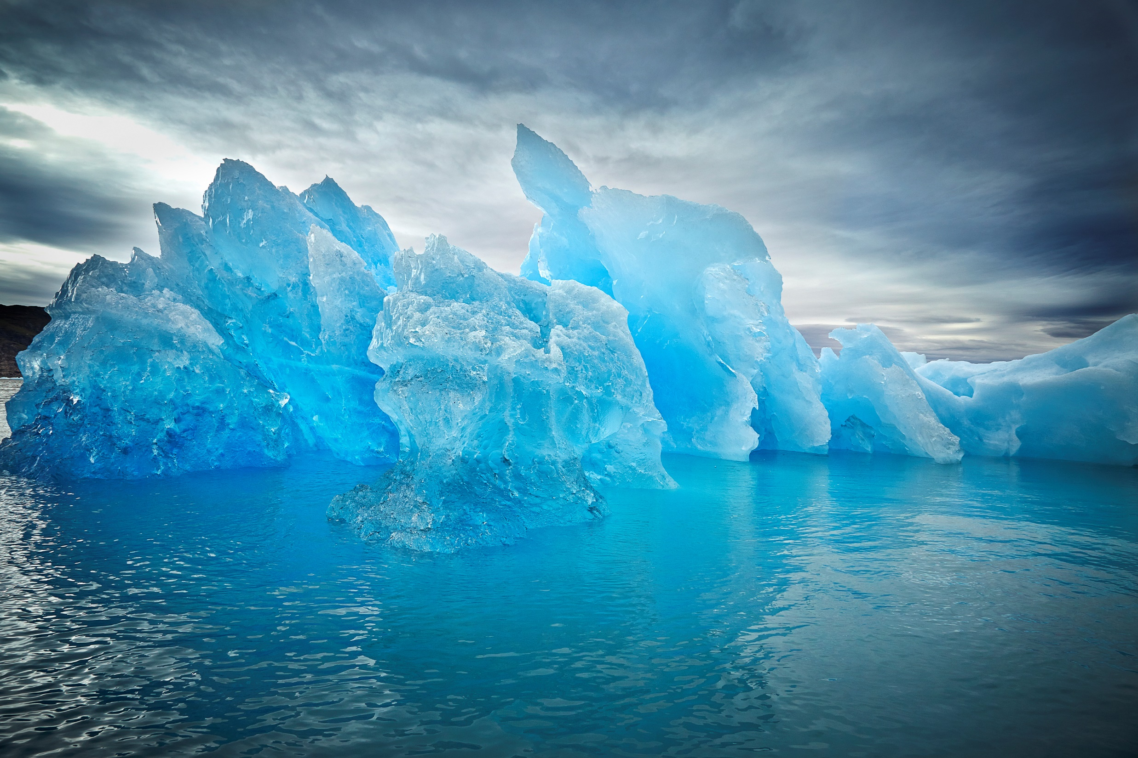
97% of all the water on Earth is salty. Only 3% is fresh water.
Of that 3%, over 2 % is frozen
in ice sheets and glaciers.

Slide 15
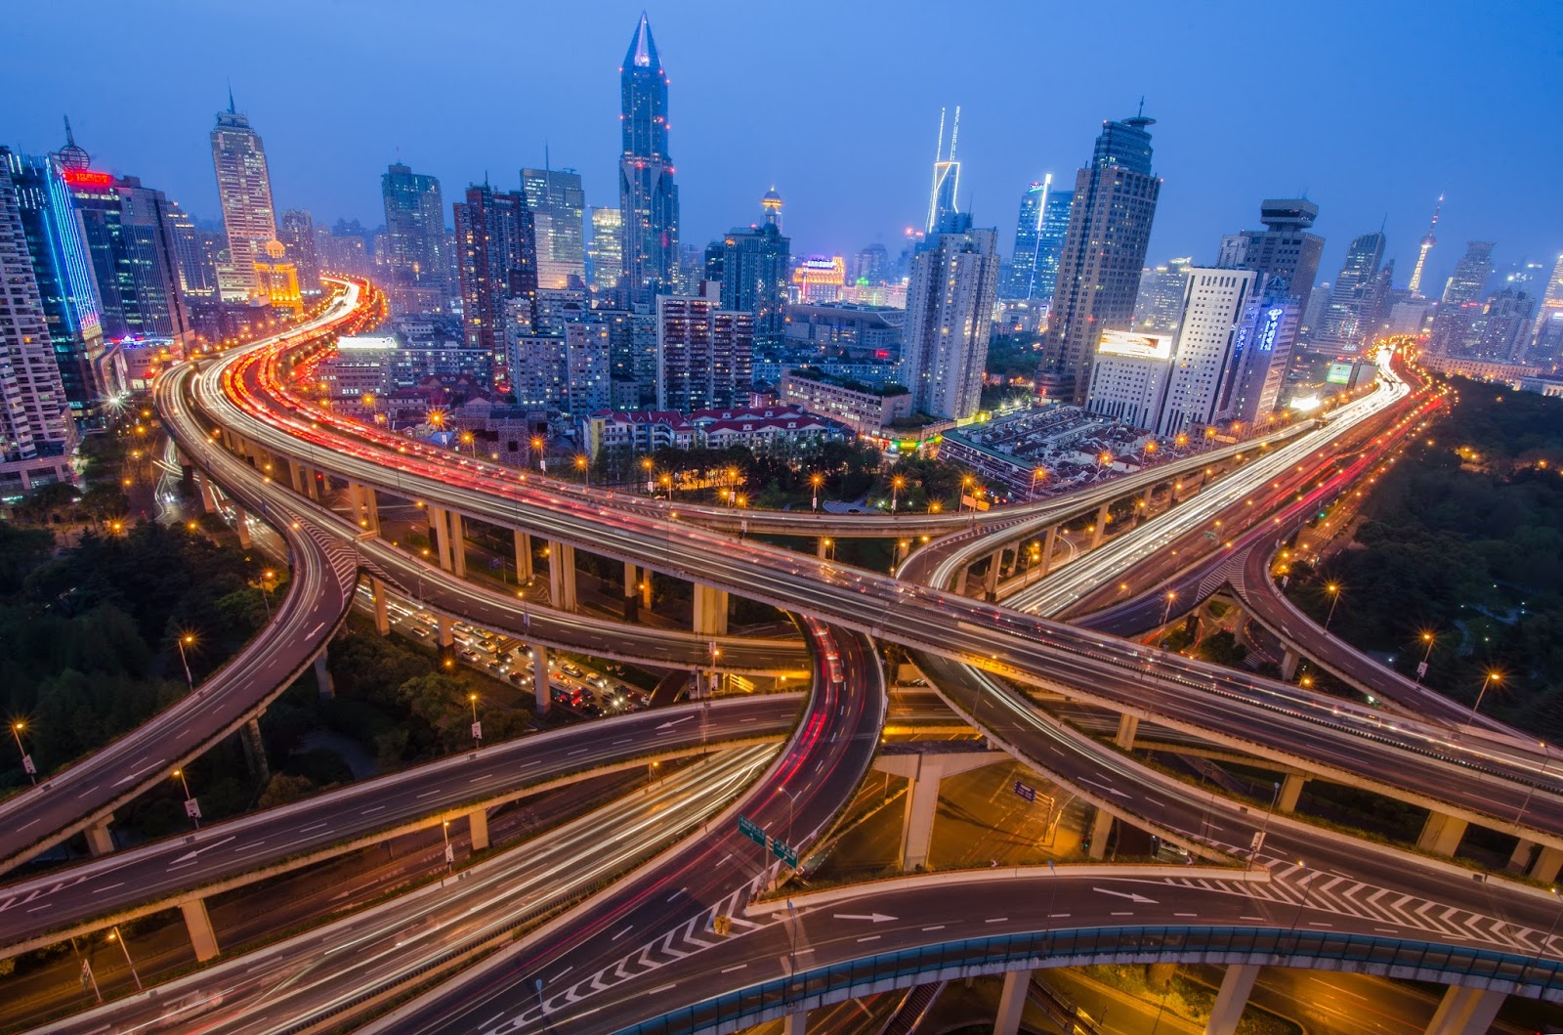
1 in 5 people on Earth are Chinese

Slide 16
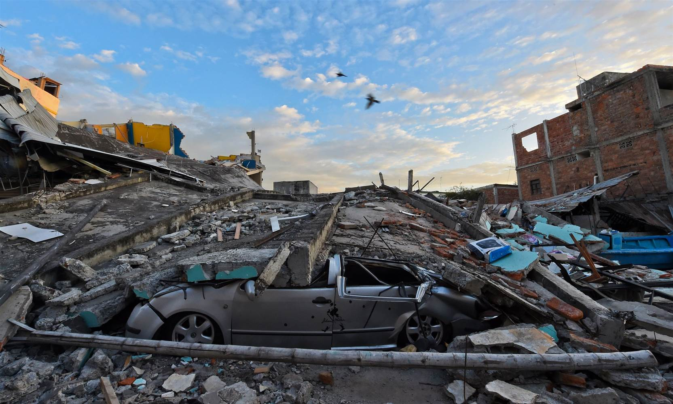
Almost a million earthquakes
occur in one year.

Slide 17
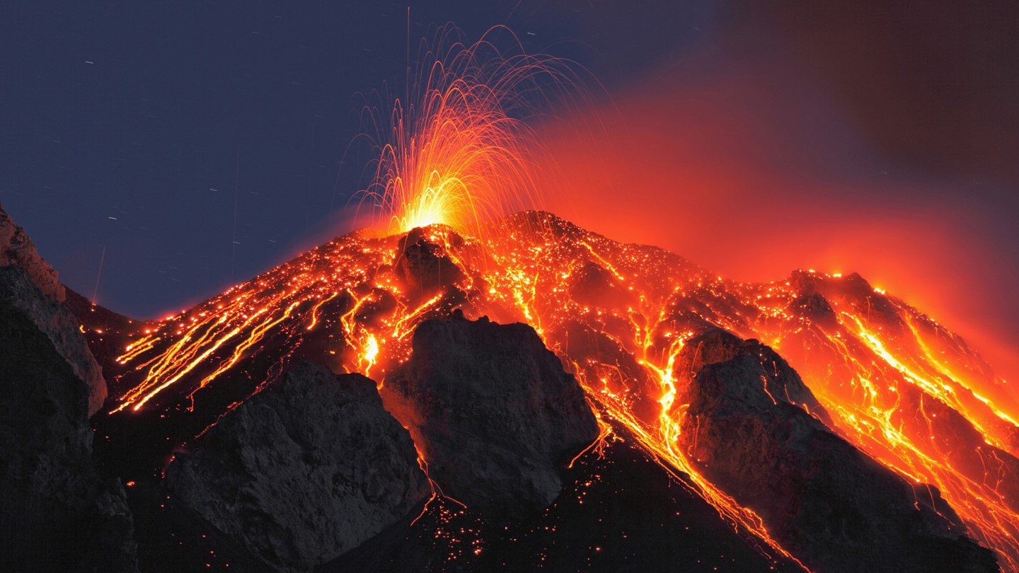
The earth has more than 600 active volcanoes.

Slide 18
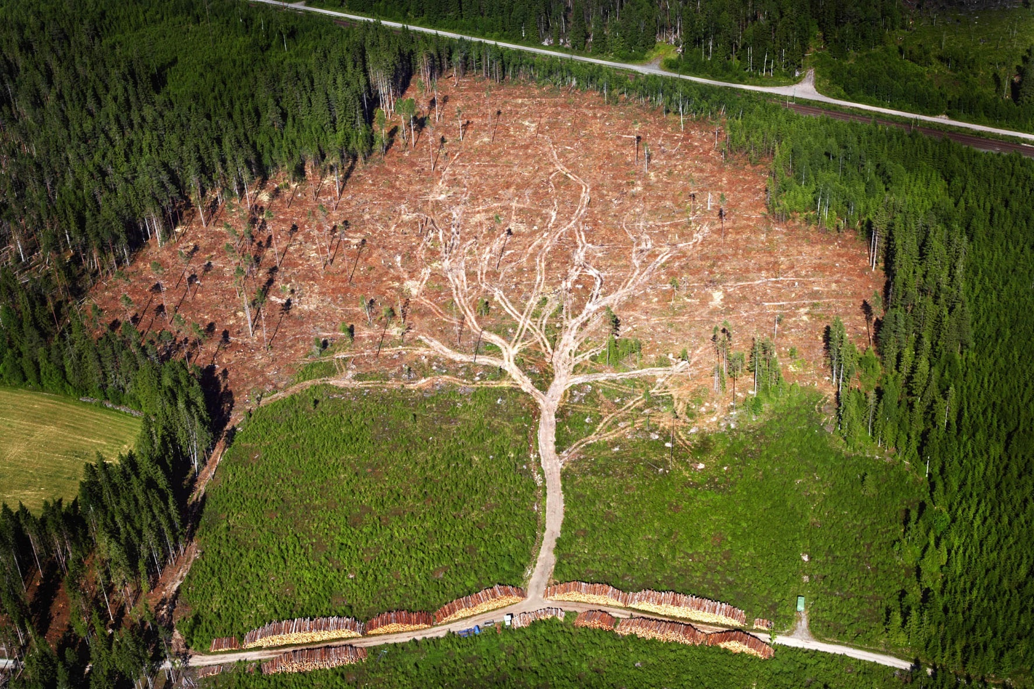
Every year, the amount of trees cut down in the world
could cover a city the size of Birmingham, with a pile of wood, ten storeys high

Slide 19
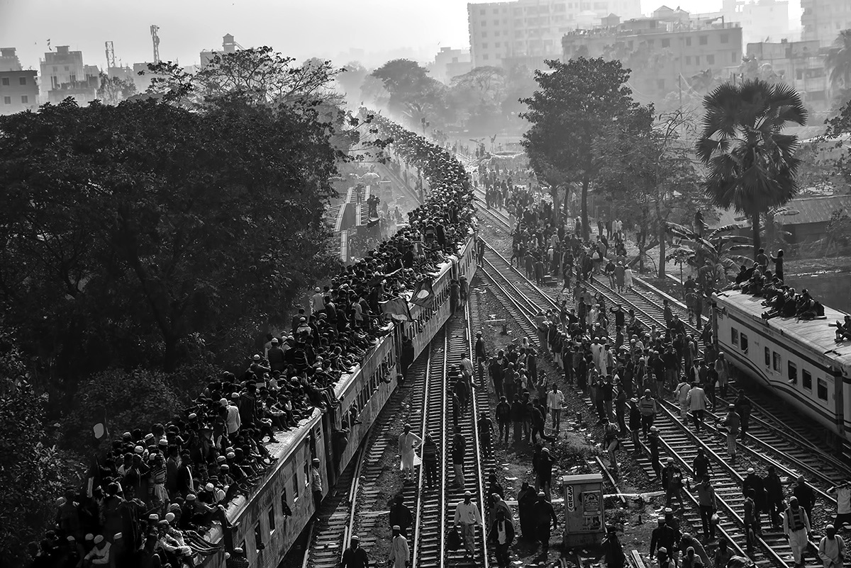
In Iceland there are 61 people
on average for each hospital bed.
In Bangladesh there are 4,586 people per bed

Slide 20
There are about 16 million thunderstorms a year throughout the world.
Over 1,800 storms rage at any moment day or night.

Slide 21
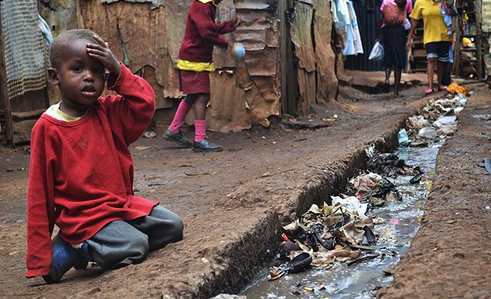
1 child every 2 minutes dies from diarrhoea.
Curing this would cost less than 50p each.

Slide 22
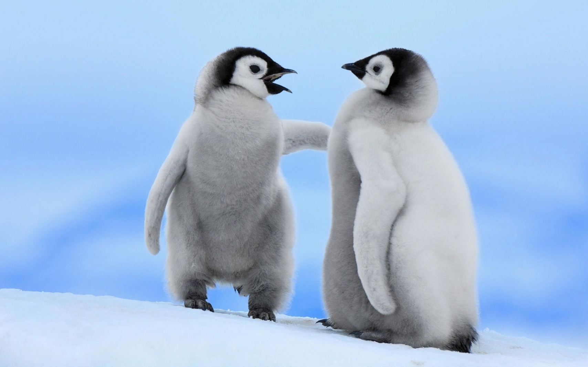
One-tenth of the Earth's surface is always under the cover of ice.
And almost 90%
of that ice is to be
found in the continent
of Antarctica.

Slide 23
A third of the world is at war. 30 million people in Africa are HIV positive. More than 150 countries use torture. Cars kill 2 people every minute …

Slide 24
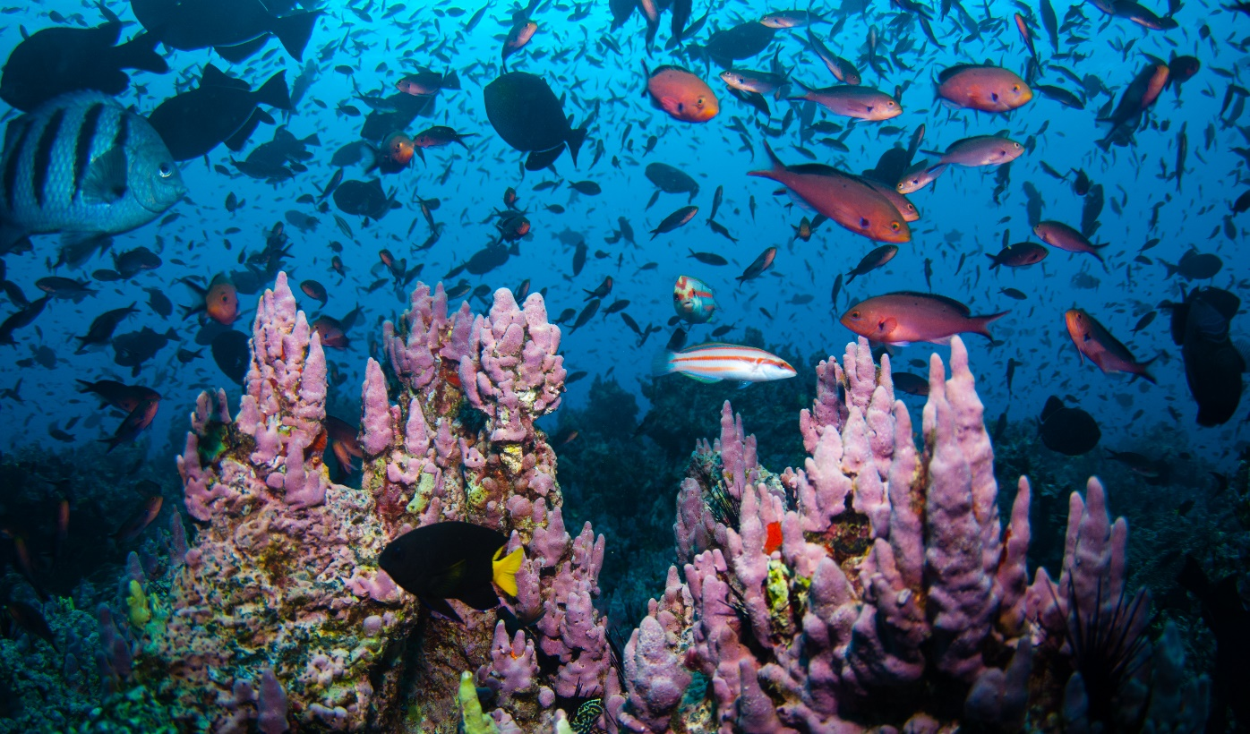
Half the world’s species could
be made extinct by 2100

Slide 25
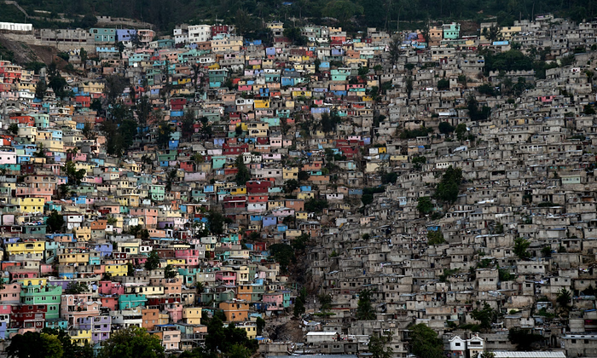
There are over 7 billion people on the planet.
This is double the population of 40 years ago.
By 2050 there is likely to be over 9 billion!

Slide 26
How would all this look
to an outsider?
You decide…

Slide 27
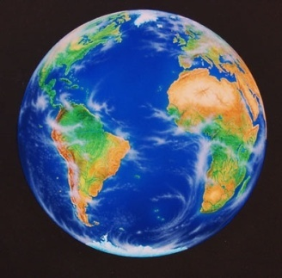
In pairs, your task is to create an illustrated information sheet about planet earth that could be used like a guide book for a visitor from another planet. You must include pictures.
Your guide to planet earth
Text here Text here
Text here
Text here
Text here
Text here
Text here Text here
Text here
Text here
Text here
Text here
I am looking for:
Accurate information about our planet
Interesting facts/issues
Labelled diagrams, pictures and maps
Neat work

