Slide 2
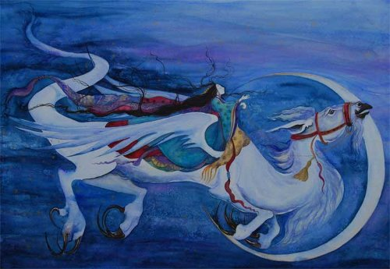
Can I craft my writing using a range of sentences and effective vocabulary?
What do you know about dragons?
Come up with three important things you know about them.
Today you are going to expand on what you know by working on your own or in pairs to Tell Me A Dragon. You need to be as creative as possible!

Slide 3
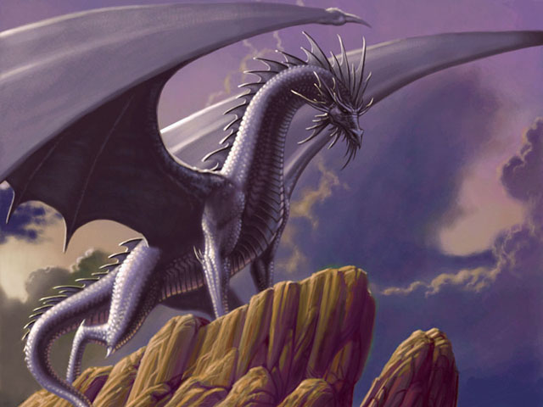
You now need to make a decision about your dragon!
Everyone has different ideas about dragons.
On the next few slides are different images of dragons.
In your pairs or on your own, have a good look at the images and decide which one appeals to you the most.
Notes:
Look at all the images

Slide 4
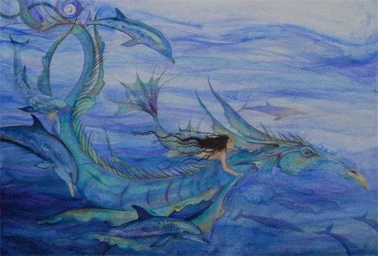

Slide 5
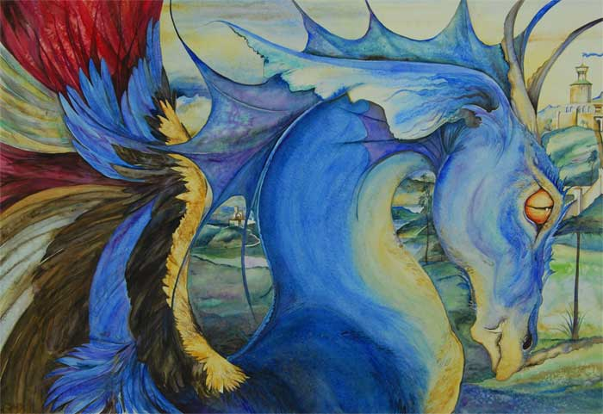

Slide 6
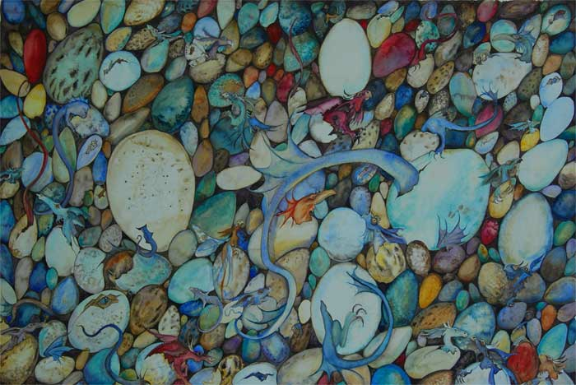

Slide 7
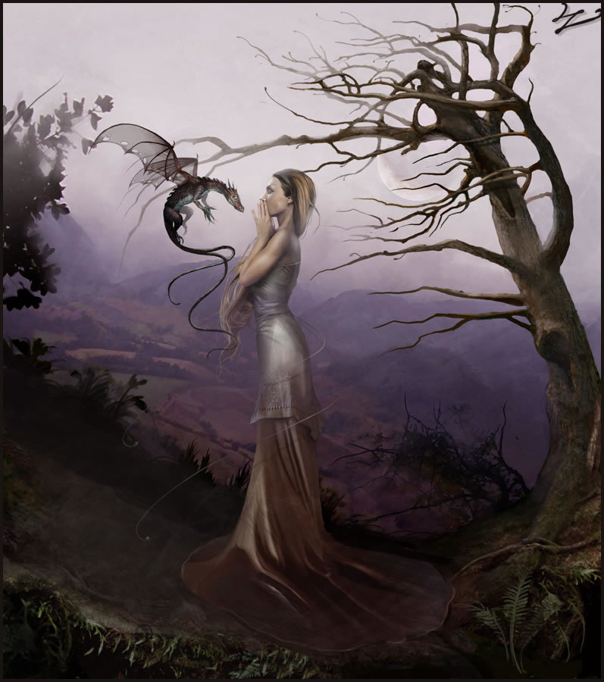

Slide 8
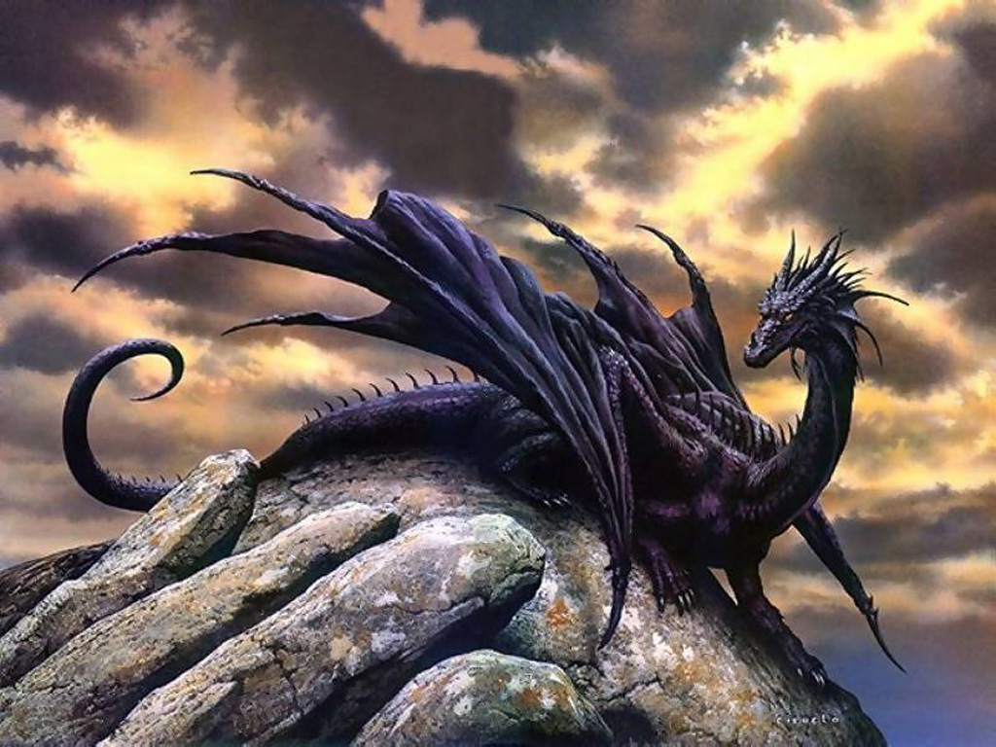

Slide 9
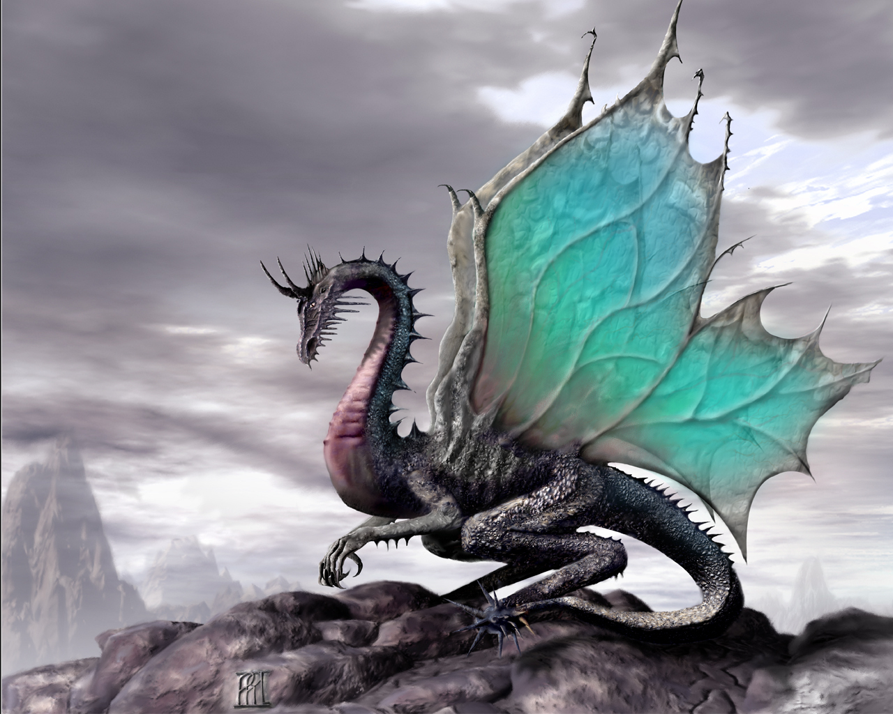

Slide 10
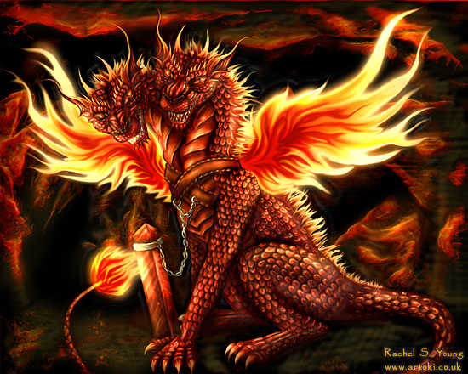

Slide 11
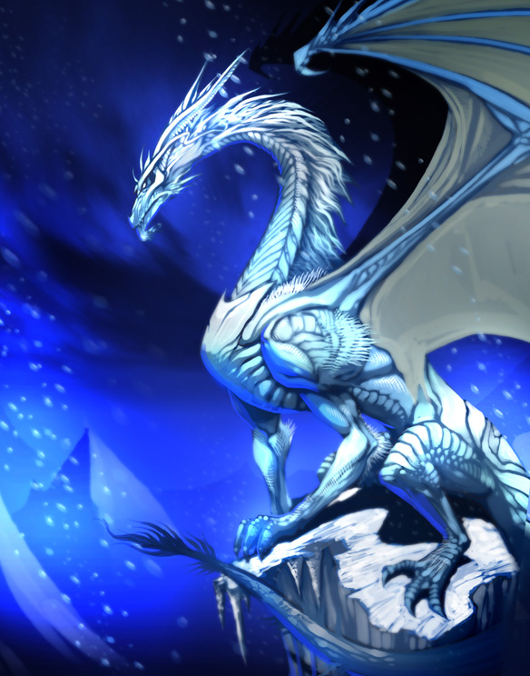

Slide 12
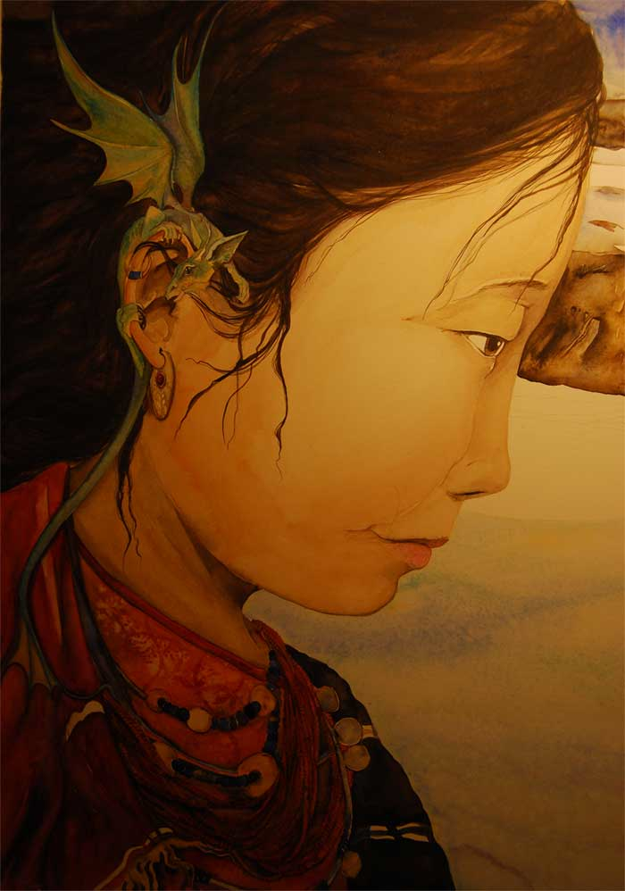

Slide 13
What type of dragon is your dragon? e.g. a star dragon | What is your dragon made of? e.g. the sun the moon stardust
How would you describe your dragon? e.g. wild-eyed fierce magical white-feathered wings golden talons powerful sinuous tail | What do you do with your dragon? e.g. ride among stars play in tails of comets chase the moonlight’s path
TELL ME A DRAGON… On the next slide, jot down some ideas about your own dragon

Slide 14
What type of dragon is your dragon? | What is your dragon made of?
How would you describe your dragon? | What do you do with your dragon?

Slide 15
Tell me a dragon
__________________________________________________________________________________________________________________________________________________________________________________________________________________________________________________________________________________________________________________________________________________________________________________________________________________________________________________________________________________________________________________________________________________________________________________________________________________________________
Read through the example descriptions on the next few slides. Then, write a paragraph describing your own dragon!
Don’t forget our aim for today’s lesson…
LO: To craft a description using a range of sentences and effective vocabulary.

Slide 16
I can:
use language imaginatively.
select precise, descriptive vocabulary.
vary sentence structures for effect.
My Dragon.
What TYPE of dragon is my dragon?
e.g. My dragon is a star dragon.

Slide 17
I can:
use language imaginatively.
select precise, descriptive vocabulary.
vary sentence structures for effect.
My Dragon.
What is my dragon made of?
Made from the sun and the moon, my
dragon is sparkled with stardust.

Slide 18
I can:
use language imaginatively.
select precise, descriptive vocabulary.
vary sentence structures for effect.
What is a verb? How has the writer used verbs below?
How do we know the phrase in blue is a simile? Why might a writer use a simile?
What effect do the adverbs in green create?
My Dragon.
How would I describe my dragon?
My dragon is wild-eyed, fierce and magical. Its white-feathered wings glide majestically through the cold night air. Golden talons slice the fragile clouds as its sinuous tail lashes powerfully across the night sky like an icy whip.

Slide 19
I can:
use language imaginatively.
select precise, descriptive vocabulary.
vary sentence structures for effect.
My Dragon.
What do I do with my dragon?
After we ride together to the secret music of the stars, we play in the dazzling tails of comets and chase the path of the silvery moon across the midnight sky.

Slide 20
Let’s look at it all together…
Words
Phrases
Punctuation
Sentences…
My dragon is a star dragon. My dragon is made from the sun and the moon and sparkled with stardust. My dragon is wild-eyed, fierce and magical. Its white-feathered wings glide majestically through the cold night air. Golden talons slice the fragile clouds as its sinuous tail lashes powerfully across the night sky like an icy whip. Together, we ride the secret music of the stars, play in the dazzling tails of comets and chase the path of the silvery moon across the midnight sky.

Slide 21
Your turn! Write your description on the scroll below…
Tell me a dragon
Self-assess
WWW:
EBI:

Slide 22
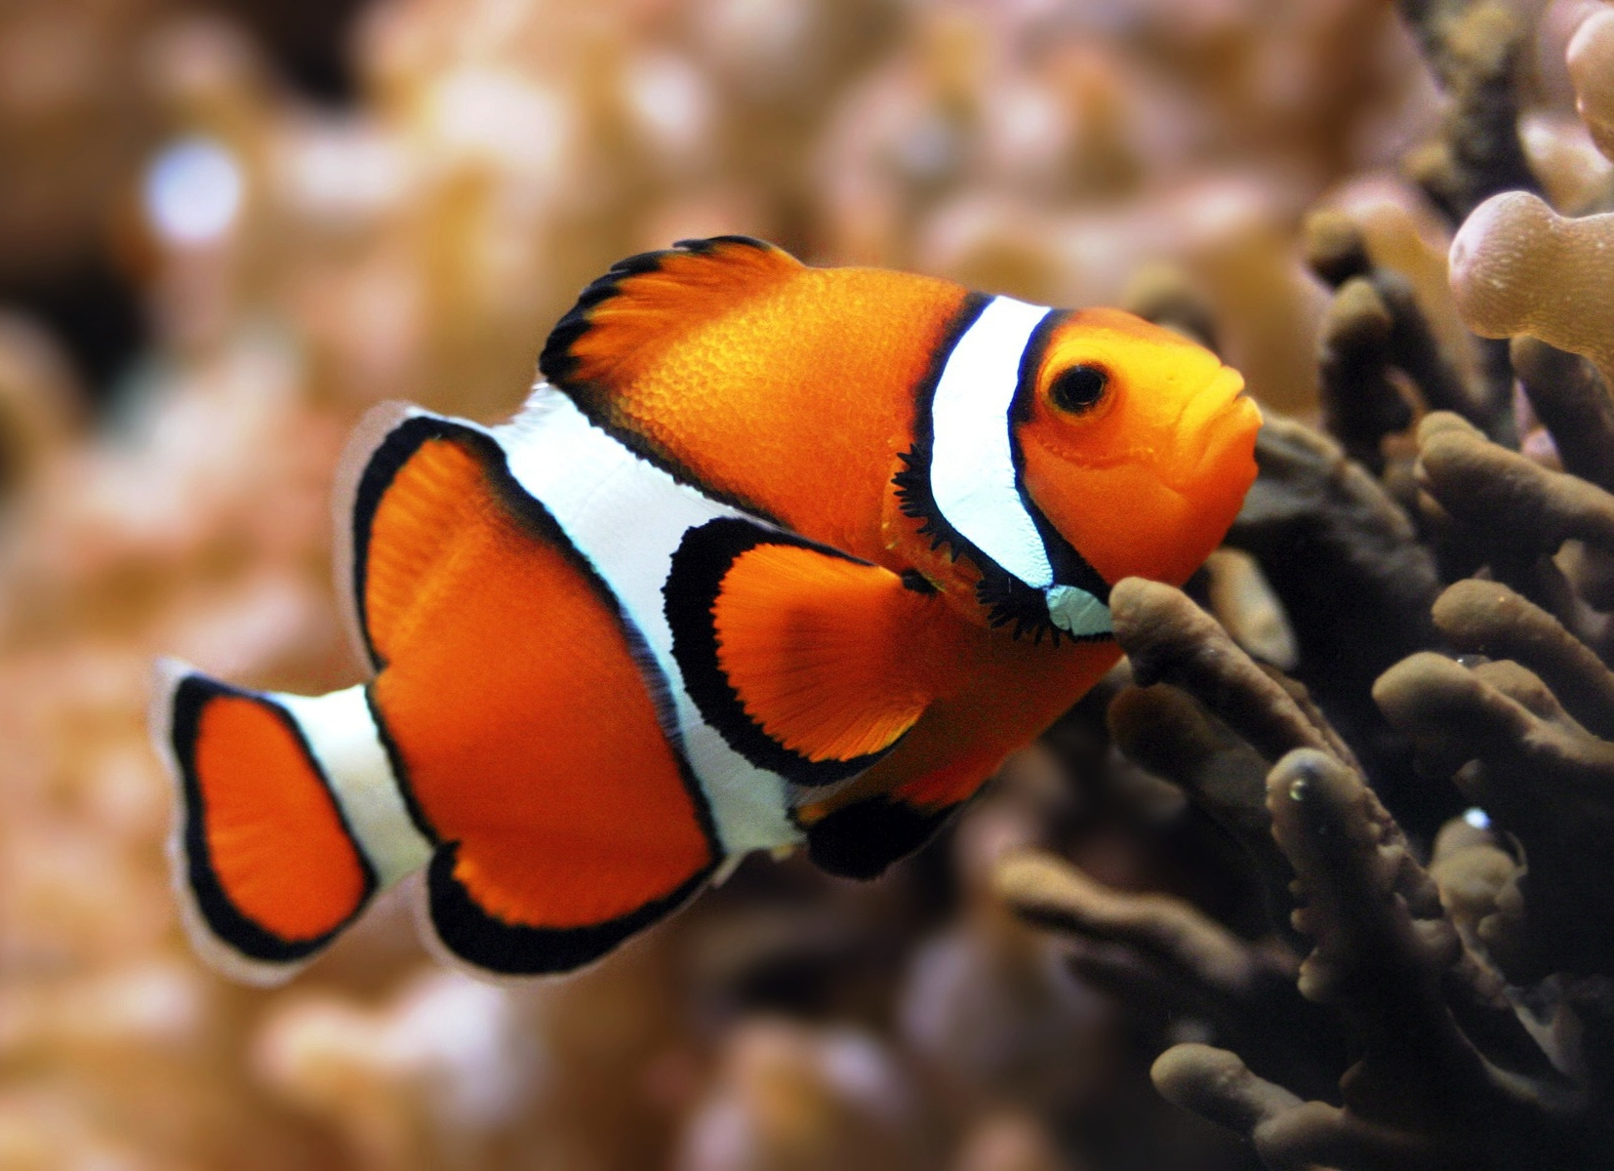
Self Assessment
Remember that when we give feedback it needs to be
FRIENDLY, SPECIFIC and HELPFUL
(FiSH)
WWW
EBI

