Slide 1
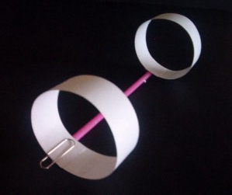
O-wing challenge
Do you think this weird contraption actually fly?
Vote now…
YES
NO

Slide 2
Today we are learning to…
Identify the variables affecting the flight of an O-Wing
Use observations to draw conclusions about the effect of wing size on the O-Wing’s performance
Evaluate your experiment to design the ultimate O-Wing
Notes:
Students are practising skills of investigation and the scientific method – a controlled experiment is a repetitive process in which one variable is incrementally changed while all others are kept constant.

Slide 3
Ideas…
What could affect the flight of an O-Wing?
Notes:
Demonstrate an O-Wing and how it flies; groups discuss and WB variables that could affect its flight. Hand out worksheets for students to record variables etc.

Slide 4
Experiment 1: Effect of Wing Size
Change the size of the front wing
(10 cm – 25 cm going up in 5 cm)
Keep the rear wing the same size
(2.5 x 25cm)
Notes:
Hand out worksheets for students to record results and conclusions

Slide 5
Carefully cut a strip of card to the size required.
Put a piece of tape on the end of the strip and curl it to make a circular wing.
Lay a piece of tape on the table, sticky side up. Stick the straw to the tape and push the wing onto the straw.
Centre both wings in the straw carefully like this:
Notes:
How to make

Slide 6
Flying an O-Wing
Hold the O-Wing in the middle of the straw
Throw horizontally and gently

Slide 7
Results
Front wing size (cm) | Distance flown (m)
 | Test 1 | Test 2 | Test 3 | Average
25
20
15
10
5

Slide 8
Conclusions
What conclusion can you make from your data?
Why did you test your flight 3 times?
Why did we share results with the class?
Evaluate your experiment: what worked well? What would you do differently?
Notes:
Students write conclusion and share ideas with each other

Slide 9
O-Wing group challenge
Which group can make the most elaborate, longest gliding O-Wing?
You will earn points for
Most “O”s used
Longest flight distance
Weirdest design as voted by the class

Slide 10
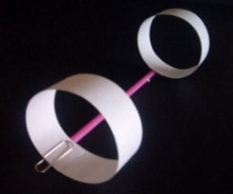
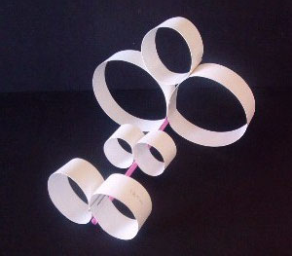
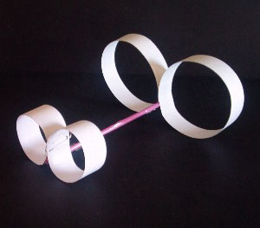
Some ideas
Ballast?

Slide 11
Group | Os | Distance | Total (Os x distance)
1
2
3
4
5
6
7
8
9
10
11

Slide 12
Experiment 2: Effect of Fuselage Length
Keep the wing sizes the same
Change the length of the fuselage

