Slide 1
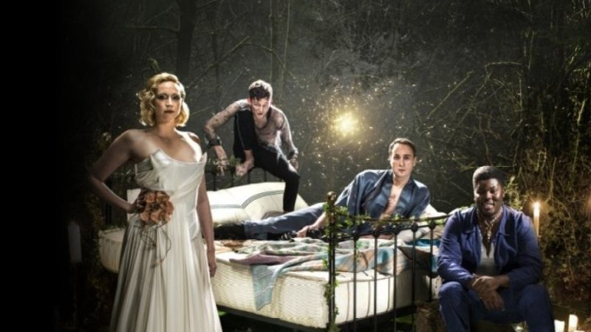
‘A Midsummer Night's Dream’
Bridge Theatre

Slide 2
DO IT NOW:
Get out your notes on ‘A Midsummer Night’s Dream’ (Bridge Theatre)
Read through your notes and think about the following:
What do you think the director’s intentions were? Why?
What were the key themes?
How were the audience made to feel involved in the production?
Which were the moments that stood out in the production and why?

Slide 3
Cast:
Production Team:
Performers:
The Nobles/Fairies:
Theseus/Oberon - Oliver Chris
Hippolyta/Titania - Gwendoline Christie
Philostrate/Puck - David Moorst
Hermia - Isis Hainsworth
Helena - Tessa Bonham Jones
Demetrius - Paul Adeyefa
Lysander - Kit Young
Egeus - Kevin McMonagle
The Mechanicals:
Quince - Felicity Montagu
Bottom - Hammed Animashaun
Flute - Jermaine Freeman
Snout - Ami Metcalf
Snug - Jamie-Rose Monk
Starveling - Francis Lovehall
The Fairies:
Peaseblossom - Chipo Kureya
Cobweb - Jay Webb
Moth - Charlotte Atkinson
Bedbug - Rachel Tolzman
Mustardseed - Lennin Nelson-McClure
Written by: William Shakespeare
Directed by: Nicholas Hytner
Production Designer: Bunny Christie
Costume Design: Christina Cunningham
Lighting Design: Bruno Poet
Sound Design: Paul Arditti
Composer: Grant Olding
Movement Director: Arlene Phillips
Hair, Wigs & Make-up: Susanna Peretz

Slide 4
Character Relationships
The Fairies:
Oberon & Titania are the Fairy King & Queen. They are fighting over the ‘Changeling Boy’ and their arguments are disrupting the balance of nature, causing weather change and infertility in the world.
Titania decides to drug Oberon to make him fall in love with Bottom, who has been ‘translated’ by magic into an ass (a donkey) as revenge for the refusal to hand over the boy.
In this version, Oberon and Titania swap roles from the original (as well as several lines).
The Nobles:
Theseus & Hippolyta are about to get married – partly to end a war between their countries and partly for love.
Hermia & Lysander are in love. Hermia’s father, Egeus, is insisting that Hermia marries Demetrius as it makes better business sense. Hermia is told that she can either marry Demetrius OR be executed OR spend her life in a nunnery – she has to decide by the Duke’s wedding day. Hermia and Lysander run away but make the mistake of telling Helena, who tells Demetrius because she wants to please him.
Demetrius doesn’t really love Hermia but wants to marry her to increase his poer and influence in Athenian society.
Helena is in love with Demetrius but he treats her badly.
The Fairies don’t like Demetrius’ attitude and intervene in the young lovers’ relationships using a plant but Puck inadvertently causes lots of confusion by drugging the wrong people!
The Mechanicals:
The Mechanicals consist of: Quince, Bottom, Snug, Starveling, Flute & Snout. They are excited to try to win a competition to perform at the Duke’s wedding. Bottom wants to play ALL of the roles. They decide to perform the play ‘Pyramus & Thisbe’. To do that, they decide to meet in the woods to rehearse.
Whilst rehearsing, Puck ‘translates’ Bottom into an ass and Oberon falls in love with him. Later, the spell is removed and Bottom can’t work out whether or not is was a ‘dream’.
The Mechanicals create a lot of humour in the play and represent ordinary people.

Slide 5
Staging
Style is immersive theatre – the audience stand throughout (except for those in the balcony) and are close to (and often involved in) the action.
Audience positioning – various positions, from traverse to thrust to in-the-round.
Sightlines – controlled by the stage positioning for the ‘groundlings’; will depend on the height of people in front. Balcony seating gets a good view but from above.
Actor/audience relationship – the immersive experience creates intimacy and drew the audience in; the balcony audience will feel distanced.
Entrances & exits – through the audience and up/down stairs to the staging blocks, which can be raised/lowered using hydraulics from the stage floor. Also had slings used for flying actors above the audience.
Use of space – extremely varied – stage floor was raised/lowered using hydraulics to create the Athenian court and the woods. A key set piece was a plexiglass rectangle LED lights embedded in the frame for Hippolyta’s cell at the start.

Slide 6
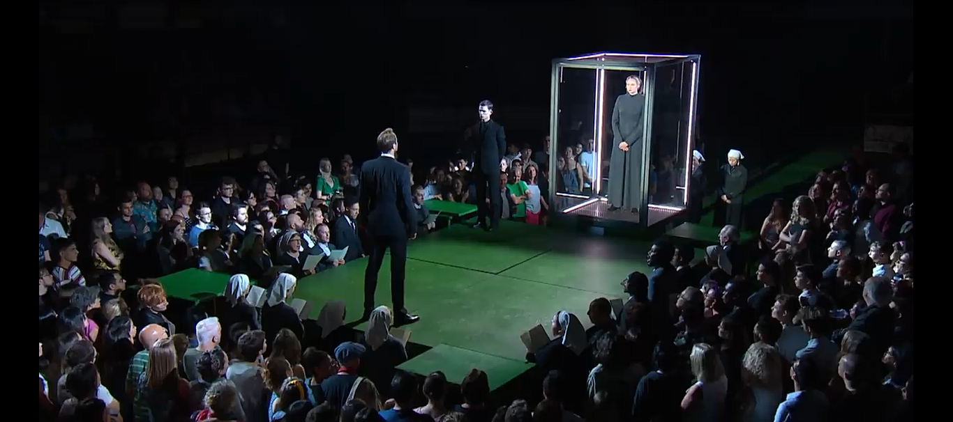
Key Moment 1: The Opening Scene
Set
Costume
Lighting
Sound
Performers

Slide 7
Key Moment 1: Opening sequence (01:14 – 10:10)
Characters in this scene:
-Theseus - Oliver Chris
- Hippolyta - Gwendoline Christie
- Philostrate- David Moorst
- Hermia - Isis Hainsworth
- Demetrius - Paul Adeyefa
- Lysander - Kit Young
- Egeus - Kevin McMonagle
Initial notes
Patriarchal, traditional society
Serious/solemn atmosphere - ritualistic
Biblical references (costume/singing psalms; layout of choir)
Establishes the world of Athens & creates a strong contrast with fairy world (glittery & fun & mischievous)
Key themes explored within this moment:
Patriarchal & matriarchal power/society

Slide 8
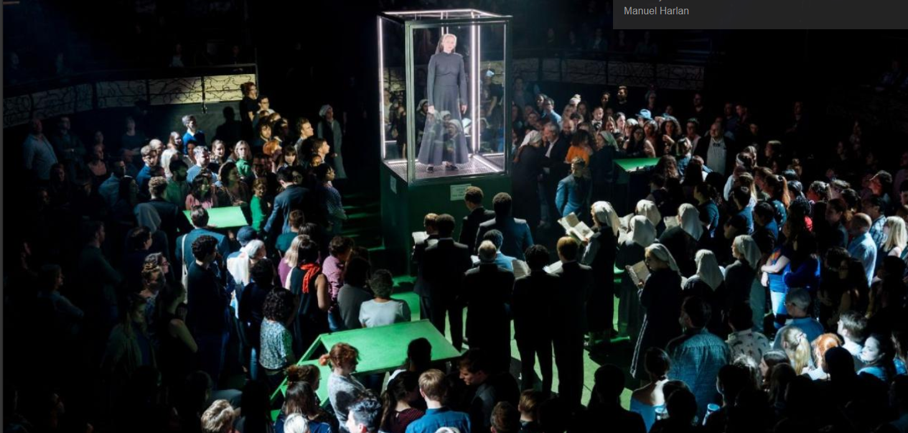
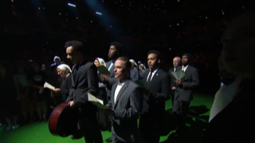
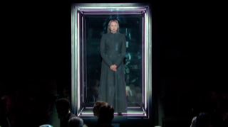
Opening sequence (01:14 – 10:10)
Sound
Psalms – choir; holy music - religious atmosphere
High pitch eery sound effect – gesture Hippolyta places hand on glass and direct eye contact with Hermia
Instrument: 9:18 – trumpet
Lysander – enters with a drum
Staging:
IMMERSIVE STYLE – intimate, greater connection between audience and actors
Traverse- when choir enter – sense of a ritual
Staging begins at floor level when choir enter – audience part of the choir
Levels then raised to audience head height
Costume
Female:
Fit / shape: heads & bodies covered up loose fitting, Dresses: modest; long sleeved; high cut around the neck (Hippolyta – ankle length; Hermia/Helena - below knee) religious/traditional attitudes
Colour / Material: White cotton headscarves = modesty & purity
Men's suits:
Material / Colour / Fit: Black suit jackets and trousers, tailored fit. White cotton shirt. formal, serious, in charge
Those in the scene = black tie but the others in chorus = no tie
Creates stark contrast with the fairy world: fun, bright, defies norms
Set
Material / Truck: Clear box on wheels surrounded with metal joins and LED lights- Hippolyta inside
Enter – Box moves through audience upstage to centre stage
Exits – centre stage to upstage
Trapped – patriarchal society
Lighting
Angle & colour: Downlighting of harsh white light creates stark, serious atmosphere
LED strip lining on interior of metal creates impression of a cell & Illuminates Hippolyta

Slide 9
Physical Skills
Movement
Gesture
Facial expressions
Eye contact
Levels
Proxemics
Body language
Tension
Opening sequence (01:14 – 10:10)
Movement:
Egeus forcefully grabbing Hermia arm dragging her in front of Theseus
Emphasis
'or to her death' Egeus warning that
'she is mine’ – property = patriarchal society
Gesture:
Hippolyta presses right hand against clear box –simultaneously eery sound effect and direct eye contact with Hermia – appealing for help?
Tone: Theseus orders Philostrate: authoritive tone- power, superiority
And 'take time to pause' - Theseus to Hermia
Gesture & eye contact:
Theseus' hand on Hermia's chin
Direct eye contact
Superior, patronising
Emphasis: Theseus 'composed your beauties' objectifying women; patronising
Vocal skills
Pitch
Pace
Pause
Tone
Volume
Accent
Emphasis
Intonation
Pause: Theseus -
'Private... schooling for you both’ – warning that he is in charge
Body language:
Theseus - upright posture, open shoulders, wide chest.
Authoritative
Facial expression:
Hippolyta lifts up the corners of her mouth to sneer at Theseus to show her contempt that he needs to keep her in a cage and show off

Slide 10
Gesture:
Hermia often points to herself or holds her chest 'I' 'Me' 'My
Inferior, unjust, no rights, ownership
Emphasising patriarchal society.
Unison in Movement & sound:
Chorus walk as a group onto the stage in traverse formation whilst singing Psalms creates a serious, religious atmosphere
Volume & Tone: Lysander 'spotted and inconstant man'
Volume increase shows rising anger.
Disgusted tone - finds Demetrius’ behaviour towards Helena shameful.
Indirect eye contact
Demetrius' reaction – shifty, uncomfortable

Slide 11
Key moment 2
Lovers argument

Slide 12
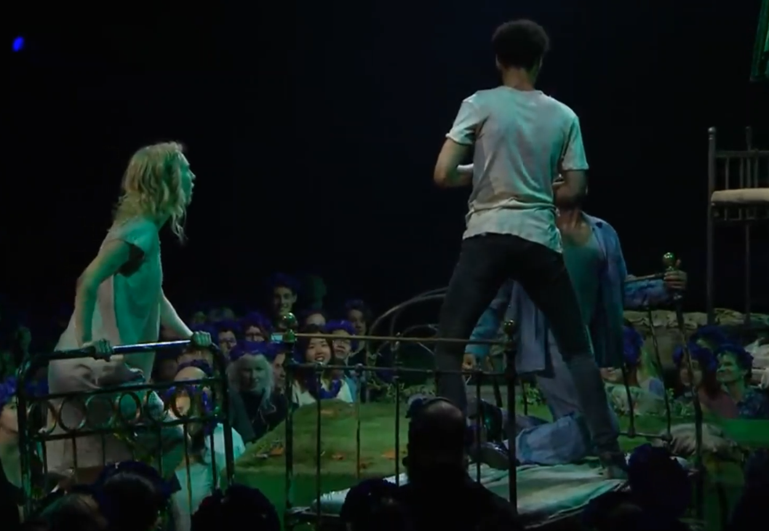
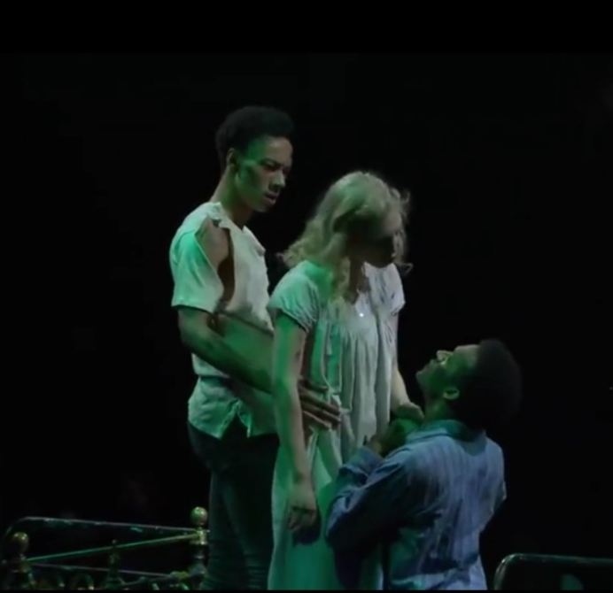
Key Moment 2: The Lovers in the woods –arguments – (1.21 - 1.32)
Physical Skills
Movement
Gesture
Facial expressions
Eye contact
Levels
Proxemics
Body language
Tension
1:21.00-1:22.40
Purpose:
To establish the enchantment – both boys in love with Helena. She feels confused and betrayed believing they are mocking her.
1
Gesture: On waking, Demetrius flings his hands to his heart in a fist shape – desire violent passion. Reaches arms outstretched, palms up, fingers curled towards Helena – desperate for her to love him back. Running fingers over his mouth – sexual desire.
Facial expressions: When Helena is disgusted – furrowed brows, mouth open, head tilted – disgust at their ‘mockery’. Helena clenches jaw – furious at continual deceit.
Eye contact: Helena is always making direct eye contact with Demetrius (more so than Lysander) to show she likes him more. Demetrius averts eye contact from Helena whilst she is ranting – shame, disappointed in himself & the reaction he is receiving.
Levels: Lysander – kneels – lowering levels – shows he would do anything for her – in awe. Melodramatic and intense – accentuates the feeling of mockery – visually looks chemically/magically induced. Helena continually switches physical levels of the set – always trying to be at a different level (initially higher – stepping onto bed, but jumps off when they follow her)– appalled – distancing – contrasting earlier behaviour in which she is chasing and following.
Vocal skills
Pitch
Pace
Pause
Tone
Volume
Accent
Emphasis
Intonation

Slide 13
Key Moment 2: The Lovers in the woods –arguments – (1.21 - 1.32)
Physical Skills
Movement
Gesture
Facial expressions
Eye contact
Levels
Proxemics
Body language
Tension
1:21.00-1:22.40
Purpose:
To establish the enchantment – both boys in love with Helena. She feels confused and betrayed believing they are mocking her.
1
Proxemics: Helena uses proxemics to show her aggressive tendencies & confusion – distancing – (using set) holding on to the other side of the bed – using it as a barrier – repulsed by boys behaviour. Especially shocking as she has surprised reactions from audience – subverting their expectations.
Body language + tension: Helena – leaning back – hands up, fingers spread in front of her shoulders – defensive – mocking how they are talking to her and exaggerated behaviour. Helena – tension – throwing arms down by side, in quick and restricted movements – accusatory nature of what she is saying and how she feels she is being mocked. Restricted = uneasy.
Vocal skills
Pitch
Pace
Pause
Tone
Volume
Accent
Emphasis
Intonation

Slide 14
Key Moment 2: The Lovers in the woods –arguments – (1.21 - 1.32)
Physical Skills
Movement
Gesture
Facial expressions
Eye contact
Levels
Proxemics
Body language
Tension
1:21.00-1:22.40
Purpose:
To establish the enchantment – both boys in love with Helena. She feels confused and betrayed believing they are mocking her.
1
Pitch: Helena “I’m sure you both hate me with your heart” – lowers pitch –growling, aggressive tone = How offensive she finds it that their behaviours have switched. Lysander – high pitched whimper as he flings his arms around Helena’s shoulders – puppy like – desperation and affection.
Pace: Helena – uses a fast, rambling pace – show her frustration, anger and disgust. Lysander & Demetrius – slow, steady, controlled pace and annunciation – lust, passion – desperate to be heard.
Pause: Helena’s lack of pauses doesn’t allow the boys to speak – her frustration and desperation for them to cease their ‘mockery’.
Tone: Lysander – “I weep” – sad, desperate tone – trying to evoke sympathy from Helena.
Volume: Helena uses a loud and domineering volume to show her frustration and desperation to be heard.
Emphasis: “I’m sure you both hate me with your hearts” inner anger “Sure” and “Hate” – accentuated by frantic hand gestures. Spitted through aggressive gritted teeth.
Vocal skills
Pitch
Pace
Pause
Tone
Volume
Accent
Emphasis
Intonation

Slide 15
Key moment 3
Flower enchantment + kiss

Slide 16
Key Moment 3: Lovers Enchantment & Kiss (2:30-5:00)
Physical Skills
Movement
Gesture
Facial expressions
Eye contact
Levels
Proxemics
Body language
Tension
2:30:00 - 5:00:00
Purpose:
To explore way the Fairy world intersects with and influences the human world. To create humour through confusion - Hermia's alleged betrayal – both girls feel confused and betrayed.
Elongation: Helena stretches the sound on "Noooo..." To show her anguish as she feels betrayed by Hermia as they've had a long history.
Volume: Hermia speaks in a stage whisper to Lysander to show a to show her disbelief that he could be rejecting her = feeling of betrayal – also need for privacy?
Pitch: Helena & Hermia vary pitch in argument – Helena is appealing to Hermia's sense of friendship.
Emphasis: Helena stresses the word "you confederacy" to show that she believes that Hermia is part of the betrayal.
Pause: Helena pauses after the line "Is it all forgot?" To show that she wants Hermia to remember their long friendship and loyalty.
Tone: Lysander uses a mocking tone on "Lysander's love" to show that he no longer cares about Hermia – only Helena.
Inflection: Hermia raises pitch of voice in a series of questions to show disbelief at Lysander's actions and lack of loyalty.
Vocal skills
Pitch
Pace
Pause
Tone
Volume
Accent
Emphasis
Intonation

Slide 17
Key Moment 3: Lovers Enchantment & Kiss (2:30-5:00)
Physical Skills
Movement
Gesture
Facial expressions
Eye contact
Levels
Proxemics
Body language
Tension
2:30:00 - 5:00:00
Purpose:
To explore way the Fairy world intersects with and influences the human world. To create humour through confusion - Hermia's alleged betrayal – both girls feel confused and betrayed.
Gesture: Hermia clutches arms around her middle as if in physical pain when Lysander tells her that he now loves Helena to show that she feels wounded and has lost a part of herself.
Facial Expression: Demetrius has wide open eyes and raised eyebrows when Helena & Heria kiss to show his intrigue and desire.
Facial Expression: Helena has a clenched jaw, open eyes and raised eyebrows on "You confederacy" to show her anger at the betrayal on Hermia's part.
Eye Contact: Lysander & Demetrius maintain eye contact with Helena when she is shouting at them to show that they feel fear and awe at her reaction.
Body language: Helena leans forward, gripping the bedstead aggressively towards Hermia, Lysander & Demetrius, who are lying on the bed together facing her; to show her rage at their apparent betrayal.
Proxemics: Helen & Hermia are distanced when Helena is kneeling and Hermia stands above her to show Helena's confusion and vulnerability.
Pace: Fast pace as Helena & Hermia kiss; then break the kiss quickly and boys rush forward then the pace slows as they react to what's happened; to highlight the moment and reactions.
Levels: Helena is standing above Hermia, lecturing her about friendship, just after the kiss to show that she is rising above their conspiracy.
Vocal skills
Pitch
Pace
Pause
Tone
Volume
Accent
Emphasis
Intonation

Slide 18
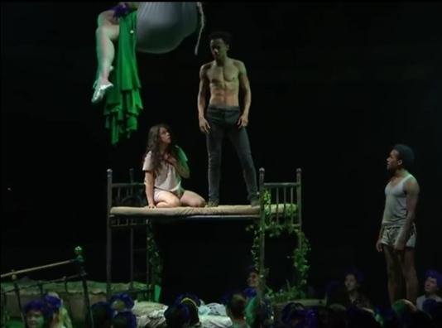
Lovers in the woods - Production elements
Sound:
Sound effect – non-diegetic - Ascending high pitched notes – twinkling introducing characters to the stage (bewitched by spell)
Composed underscore – non-diegetic – fermata (note being held/sustained) high pitched – chimes twinkling – high pitched strings Tremolo (quick repetition of same note) = duration of Puck/Titania’s spell – actions being controlled by magic.
Retrograde - (music being played backwards) fast tempo – undoing the temporary control of Puck/Titania.
Set:
Beds:
Material/colour – Matt dull dark grey metal frame – rustic, fit into nature setting, don’t reflect the lighting. Size/shape: Thin framing allows ‘in the round’ audience to see the action through set.
Adornment- Ivy leaves woven around frame – nature setting, blends into staging flooring (green soft fabric = grass)
Levels: Provides variety of heights (extended legs of beds)– allowing Helena to disappear into the audience, sending the other 3 character’s into commotion to re-appear the other side of the stage (“I’m hereeee”) Comedic. Allows for ‘chase’ between Helena & boys.
Aerial silks:
Levels: Puck and Titania – suspended from auditorium ceiling – position of power and control – all-seeing, mischievous & graceful – lowered in & out for potions.
Colour/Material: Shamrock Green Nylon – slight stretch – freedom of movement – graceful – fairy-like. Blends in with nature/forest setting.
Lighting:
ParCan – Blue gel wash – low intensity – spilling on audience and actors – midnight – moonlight – soft romantic setting.
LEDs – White – spilling centre stage - downlight (from above) Illuminating actors & casting soft shadows – mystery – not all is as it seems.
Spotlight – narrow low intensity focused beam – illuminating Puck/Titania at key moments (prior to entrances/control)
LEDs – Green – low intensity – illuminating Puck/Titania in Aerial silks – part of the forest surroundings.

Slide 19
Lovers in the woods - Production elements
Costume:
Helena:
Material / Colour / Fit – White cotton, loose fitting old fashioned night gown – traditional and pure – almost angelic with blonde hair.
Shape – Ankle length - covers shoulders and high necked – modest.
Hermia:
Material / Colour / Fit – White cotton, loose fitting shirt and shorts – more modern Shape – covers shoulders but legs exposed = challenging Athenian rules to be with Lysander.
Pattern: light stripes (beige and white) reflective of pyjama pattern.
Lysander:
Material / Colour / Fit – Black Demin jeans – black belt – modern Texture - rough – topless. breaking Athenian rules to flee with Hermia.
Demetrius:
Material / Colour / Fit – Blue and white stripped cotton loose fitting pyjama’s – white vest and shorts underneath.
Shape - Shirt top is unbuttoned revealing vest – more traditional layers with modern twist. Initially respectful of Athenian law.
Removes layers as argument and lust progresses – ends in just white boxers and vest.

Slide 20
Example paragraphs

Slide 21
9a Example paragraph:
Analyse how physical skills were used to engage the audience at one key moment in the performance. (6 marks)
Identify the command words in the question.
Analyse how physical skills were used to engage the audience at one key moment in the performance. (6 marks)
Select the most appropriate key moment to discuss
Use the structure:
Inuits - Introduction
Kill – Key moment
Englishmen - Explain
With - What
Harpoons - How
Whilst - Why
Laughing – Link to command words
You should be writing two detailed paragraphs for this question. (2-3 skills)
Notice this is a slightly different order to AICs – the content is the same, but the key moment comes first.

Slide 22
Analyse how physical skills were used to engage the audience at one key moment in the performance. (6 marks)
I - A Bridge Theatre’s ‘A Midsummer Night’s Dream’ relied heavily on the physicality of the actors to engage the audience in the magical mayhem and help them understand the Shakespearian language of the text.
K+E - One moment this was particularly effective was during the Lovers argument after the potion had been applied to their eyes causing Lysander and Demetrius to fall in love with Helena. The exaggerated nature of this scene created a great sense of engagement and comedy for the audience.
W – Paul Adeyefa, playing Demetrius exaggerates his use of gestures as his character wakes,
H – by flinging his hands to his heart in a fist shape, then reaching his arms outstretched, palms facing up, fingers curled towards Helena
W – this shows Demetrius’ desperate for her to love him back, the rapid pace reinforces his character’s almost violent passion.
L – I found these physical skills highly engaging and comical as it presented his character as an overdramatic love-sick puppy, helping me to understand the power of the chemically induced romance and causing me to feel sympathy for Helena and the sense that she was being mocked.

Slide 23
Analyse how physical skills were used to engage the audience at one key moment in the performance. (6 marks)
I - A Bridge Theatre’s ‘A Midsummer Night’s Dream’ relied heavily on the physicality of the actors to engage the audience in the magical mayhem and help them understand the Shakespearian language of the text.
K+E - One moment this was particularly effective was during the Lovers argument after the potion had been applied to their eyes causing Lysander and Demetrius to fall in love with Helena. The exaggerated nature of this scene created a great sense of engagement and comedy for the audience.
W – Tessa Bonham Jones playing the character of Helena, uses the physical skills of proxemics and levels
H – by constantly distancing herself from the boys, she initially leaps onto the higher level of the bed, but quickly jumps down when the boys follow her, she then interacts with the set by holding onto the bed frame in order to create a barrier between herself and the boys
W – To show her wanting to distance herself from this mockery, as she’s hurt from their cruel jokes and wants to shield herself from the emotional pain caused from this.
L – I found these physical skills engaging because it helped to show the abusive, strained, one-way relationship between her and the boys and how she is feeling confused and angry because she is being mocked due to the spell that has been placed on them.

Slide 24
9b Example Paragraph:
Evaluate how the set design created impact within the performance. (9 marks)
Identify the command words in the question.
Select the most appropriate key moment to discuss.
Use the structure:
Inuits - Introduction
Kill – Key moment
Englishmen - Explain
With - What
Harpoons - How
Whilst - Why
Laughing – Link to command words
Repeat for TWO more examples.
You should be writing THREE detailed paragraphs for this question. (3 key moments)
Notice this is a slightly different order to AICs – the content is the same, but the key moment comes first.

Slide 25
9b) Evaluate how the set design created impact within the performance. (9 marks)
I - Bridge Theatre’s ‘A Midsummer Night’s Dream’ created a truly immersive experience for the audience using the set design. The stage floor could be raised and lowered in sections as needed, which made the space extremely flexible and there were only a few key pieces of set. These were visually impressive and created a greater impact and an intimate connection between audience and actors.
K+E - One moment that was particularly effective was the opening sequence in which the cast enter and process through the audience who are positioned in a thrust formation. The sombre, religious mood of this scene created a serious atmosphere for the audience. The impact of this is to draw the audience into the ritualistic nature of the scene and make them feel a part of the action.
W – The Production Designer, Bunny Christie, had created a transparent box surrounded with metal joins which were lined with LED lights. Hydraulics were also used to raise several sections of the stage floor.
H – The cell was flown in from upstage to centre stage with Hippolyta inside and lowered to meet a section of the stage floor, which was raised to audience head height just as the hymn finished with Theseus facing the cell and Philostrate standing next to it.
W – This shows Theseus’ need to assert his authority over Hippolyta as she is trapped in a cell and then displayed to Athenian society on his orders. The sense of dominant male power is firmly established as he is raised up and then paces freely in front of her cell.
L – I found the set design in this sequence highly impactful as I was intrigued by the deliberate contrast between the modern-looking cell and the traditional and patriarchal presentation of Athenian society through the other production elements as it hinted that there might be more surprises to come in this production.

Slide 26
9b) Evaluate how the set design created impact within the performance. (9 marks)
I - Bridge Theatre’s ‘A Midsummer Night’s Dream’ created a truly immersive experience for the audience using the set design. This was visually impressive and created a greater impact and an intimate connection between audience and actors.
K+E - Another key moment that was particularly effective was the start of the Lovers’ argument scene, when Helena runs in and is followed by Lysander and Demetrius; all watched over by Titania and Puck. The set is important in this scene because the slings allow fairy interference from above and the beds imply the time of day.
W – The Production Designer, Bunny Christie, had designed it so that there were two slings suspended over the central stage sections. Several sections of the stage floor were raised and three simple iron bedsteads were each positioned on the different sections of the staging.
H – As the scene began, Titania and Puck were sitting in the slings above the audience. The stage sections were raised by hydraulics at different levels centre stage and upstage right with the audience surrounding them on all sides. Two of the bedsteads were positioned at right angles to each other on the centre stage and the other was on the opposite section of staging, facing them.
W – The raised staging ensured that audience sightlines were good; the use of the beds reminded the audience that the setting is at night in the woods; the slings remind the audience that the fairies are magical and have their own set of values and rules.
L – I found this set design highly impactful because the suspension of the fairies above the humans emphasised the Fairies’ ability to interact with and influence events in the human world, challenging sexist behaviour and encouraging tolerance and understanding of those who do not necessarily fit traditional society’s expectations.

Slide 27
9b) Evaluate how the set design created impact within the performance. (9 marks)
I - Bridge Theatre’s ‘A Midsummer Night’s Dream’ created a truly immersive experience for the audience using the set design. This was visually impressive and created a greater impact and an intimate connection between audience and actors.
K+E - Another key moment that was particularly effective was the final scene, in which the Nobles celebrate their weddings and the Mechanicals perform their version of ‘Pyramus and Thisbe’, observed by the Fairies. The set helps to create a formal setting.
W – The stage floor was raised to create one large central section with three smaller separate sections with chairs on them
H – by raising the stage floor in sections using hydraulics in a square formation with three smaller sections at the sides with chairs positioned side by side for each couple.
W – To show that the location was the Court and that the nobles were watching the wedding entertainment in a formal setting.
L – I found the set design to be highly impactful because it created a juxtaposition between the formal setting and the celebratory atmosphere which contrasted with the solemnity of the opening scene, reminding the audience of the journey that the characters have been on, learning tolerance and acceptance of diversity.

