Slide 1
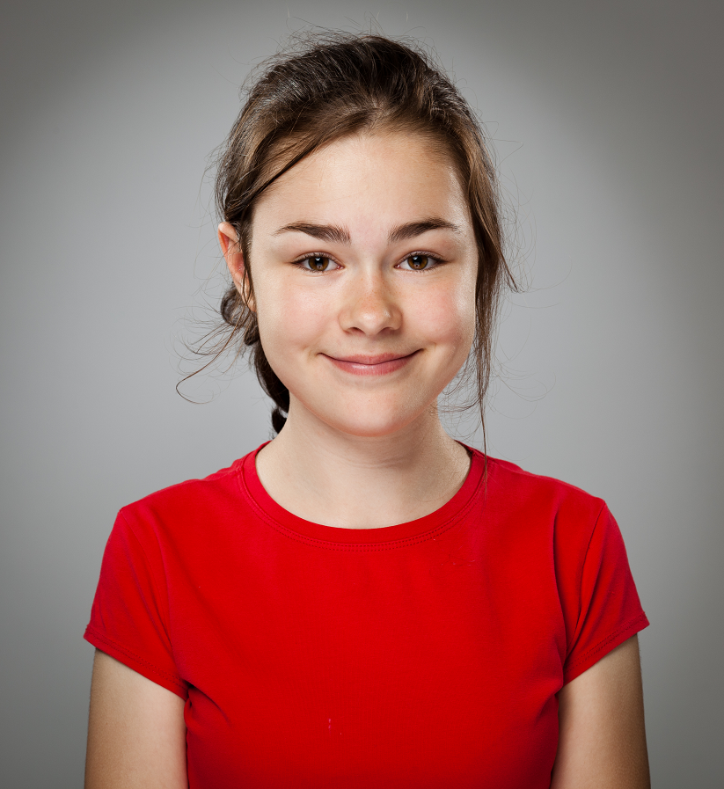

Safeguarding Children and Young People
Information to keep you safe
-
How you can help friends
-
Who you can contact to get help
-
How services work to keep you safe
#hearmyvoice
Notes:
Facilitator instructions and explanation: (see slides 18 and 19 for a full description of the facilitator notes)
Everyone working with children and young people have a ‘duty to safeguard’ them. This resource has been developed so that staff in schools and education settings (Key Stage 3, 4 & 5) can use it to raise awareness of safeguarding key themes with young people. It is essential that the facilitator is familiar with the content and links in each slide. Videos should be viewed before showing and the facilitator should be clear on the direction they want to take regarding discussions and debate.
It is crucial that the facilitator considers the vulnerability of students involved as this may trigger strong emotional responses to the issues included. The facilitator will need to consider appropriate additional support or opportunity for pupils to ‘’opt out or step out”.
The facilitator should set a group agreement to ensure the possibility of inappropriate discussions / disclosures are reduced. This will also help young people feel safe to participate in discussions. The group agreement should be displayed in every session and as part of the introduction, important statements such as ‘confidentiality’ could be reinforced to remind students of their rights.
Before the session is complete, students should be given the opportunity to take part in a closing round, this will help process any remaining feelings and to ensure closure. It will also provide the facilitator informal feedback about the session.
Explain what the content of this presentation will include (4 points on this slide).
Information to keep you safe
How you can help friends
Who you can contact to get help
How services work to keep you safe
Introduce the term ‘Durham Safeguarding Children Board’ (next slide will say what LSCB does).
Participant discussion:
Why do you think “safeguarding is everyone’s responsibility?”
Additional information for facilitators:
#hearmyvoice is a simple way for young people to express their views around safeguarding on social media. This is covered on the final presentation slide (17).
Video/audio clips:
Throughout this presentation some slides have links to video clips that show the issue and enable further discussion. Some may appear to be more suitable for a younger audience however this is a ‘distancing technique’, whereby students can discuss the issues generally.

Slide 2
What is Safeguarding?
What is Safeguarding? | Safeguarding Themes | Getting Help
What does DMAT do?
We promote the welfare of children and young people, safeguarding them from harm and protecting those children who are at significant risk of harm or neglect.
What does it mean for me?
Agencies including the Devon Children’s and Families Partnership, the Police, Schools and Colleges and Health Services such as GPs, Hospitals and Health Visitors are all here to help.
What is safeguarding?
Safeguarding is about keeping children and young people safe and protecting them from harm, while making sure they grow up in a safe environment.
Our Vision: Every child and young person feels safe and grows up safe from harm
2
Notes:
Facilitator instructions and explanation:
Reinforce the idea that safeguarding is everyone’s responsibility whether student / friend or adult.
The facilitator might need to spend time exploring the concepts of keeping children and young people safe and protecting them from harm.
Participant discussion:
Can students give other examples of services / organisations or individuals whose duty it is to keep children and young people safe? (e.g. youth clubs, scouts, football clubs, dance groups, private tutors, counsellors, school crossing patrol etc.)
What does ‘protecting them from harm’ mean?
What is a safe environment?
Additional information for facilitators:
Facilitators may want to show the LSCB website for further information on their function and role www.durham-lscb.org.uk (see link at top of each slide).

Slide 3

Safeguarding Themes
What is Safeguarding? | Safeguarding Themes | Get Help
Child Sexual Exploitation
Child Abuse
Neglect
Domestic Abuse
Female Genital Mutilation
3
Notes:
Facilitator instructions and explanation:
This slide introduces the key themes of safeguarding. By clicking on each door – this will take you to a more detailed explanation of the issue. Within the theme ‘Child abuse’, physical, emotional, sexual abuse and neglect will be covered. Under the heading Child Sexual Exploitation, ‘Nude’s (or sexting) will be addressed.
At this point the facilitator can focus on just one theme and look at this in depth. Other themes can be explored at different times.
The home button at the centre bottom of each slide will take you back to this overview slide.

Slide 4
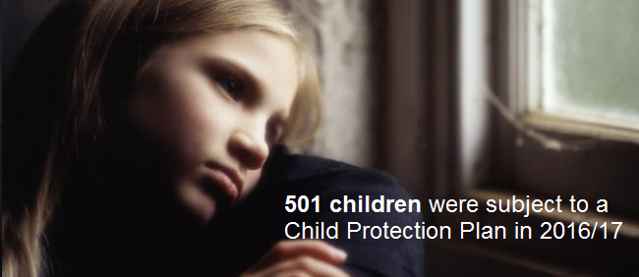



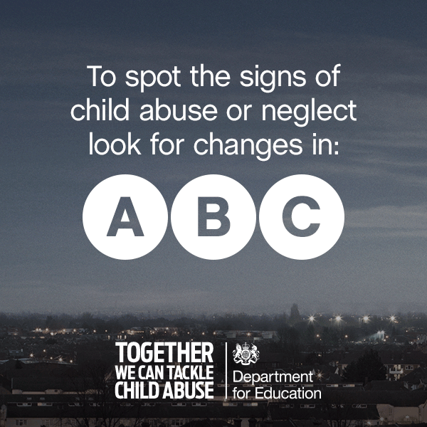

Child Abuse
What is Safeguarding? | Safeguarding Themes | Get Help
What is Child Abuse?
When people talk about child abuse they usually mean one or more of four things:
Sexual abuse – When a child or young person is forced into sexual activities (images, touching, sex).
Physical abuse – When a child or young person is physically hurt by an adult (hitting, kicking, punching).
Emotional abuse – When a child or young person has cruel, unkind things persistently said to them (making them feel unloved, unwanted).
Neglect – When a child or young person is not looked after properly and not getting the things they need to thrive. (food, shelter, warmth).
Get Help
  Services can work with everyone in the family helping them to find solutions to their problems.
4
Notes:
Facilitator instructions and explanation:
This slide covers the 4 elements of abuse. They can occur on their own but are often linked. The following 4 slides deal with each type of abuse in more detail.
Participant discussion:
Encourage students to explore each element of abuse and identify how they might be interconnected.
If young people are at risk or have experienced child abuse which agencies might be able to help?
Reinforce agency contact details.
What is a child protection plan?
ABC can be a useful tool for students to consider if abuse in any form may be happening to a friend / family member.
Additional information for facilitators
Explore with students ‘agencies’ roles and responsibilities; what they can do and what they don’t. For example, many children think contact with social care means automatic removal of a child from the home / situation and loss of contact with family / carers.
Participant reflection
‘Myth busting’ students can reflect on what they have heard / think they know about abuse and agency involvement.

Slide 5
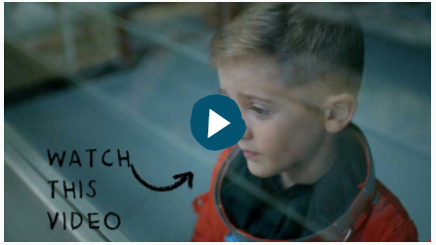
Physical Abuse
Safeguarding Overview | Safeguarding Themes | Reporting Concerns
What is Physical Abuse?
Physical abuse is deliberately hurting a child or young person.
It isn’t accidental - children who are physically abused suffer violence such as being hit, kicked, poisoned, burned, slapped or having objects thrown at them.
Shaking or hitting babies can cause non-accidental injuries such as head injuries.
Causing injuries such as bruises, broken bones, burns or cuts.
Fabricated or induced illness
  Fabricated or induced illness is when a parent or carer fakes, or creates, the symptoms of an illness in their child. This might include giving a child medicine, tampering with medical equipment or falsifying test results.
  Although it’s not very common, it is a serious form of child abuse.
5
Notes:
Facilitator instructions and explanation:
Following on from the previous slide, this looks at examples of physical abuse. It is important to note that bruises and injuries to non mobile babies are an immediate safeguarding concern.
Participant discussion:
Could smacking a child be considered physical abuse?
What might students / pupils consider ‘acceptable’ in relation to physical chastisement? What are the boundaries?
Why have some countries banned smacking (e.g. Scotland)?
Can this be seen as ‘big brother’ or a ‘nanny state’ ?
Additional information for facilitators:
Fabricated or induced illness - sometimes referred to as ‘Munchausen Syndrome by Proxy’ (MSBP) is another title for this type of abuse. This form of abuse is not common but does happen and often becomes highlighted in the media / press. It can initially be hard to spot or detect. Students may want to explore real life or dramatized examples.
• Video/audio clip:
A video produced by the NSPCC- Alfie the 7 year old astronaut. The advert highlights domestic abuse in the home from the child’s perspective. This provides an opportunity to discuss the effects of physical abuse and domestic violence on children and young people.

Slide 6
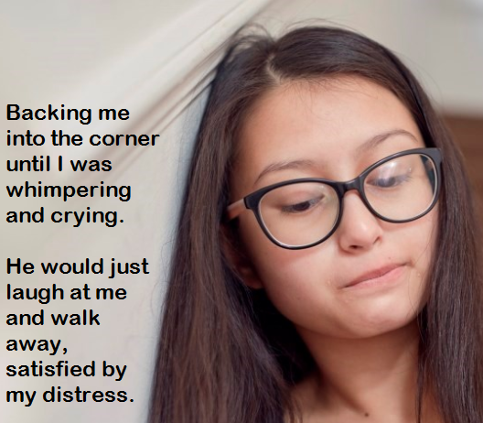



Emotional Abuse
What is Safeguarding? | Safeguarding Themes | Get Help
What about Bullying?
What is Emotional Abuse?
Persistent emotional abuse can cause severe or adverse effects on a child’s or young person’s emotional development.
Examples include telling a child they are: worthless, unloved, or unwanted.
Lack of praise and love can restrict development.
Some level of emotional abuse is involved in all types of child abuse, though it may occur alone.
  Bullying can make you just as unhappy as if you are being abused in some other way.
  Bullying can happen at any time, anywhere and to any child, although it most commonly happens to children and young people of school age. It can be carried out physically, verbally, emotionally or online (cyber bullying).
What about Self-Harm?
  Self-harm is when you hurt or damage your own body on purpose. It's usually a way of coping with emotional stress.
  Young people say that conflict with family, teachers, boyfriends and girlfriends are common reasons for self-harm.
  You can get private and confidential help from PAPYRUS www.papyrus-uk.org or you can call them on 0800 068 41 41.
‘You’re a moron’ – ‘I was better off without you’ – ‘You’re always in the way’.
6
Notes:
Facilitator instructions and explanation: This is a complex area and may need to be given time.
The slide contains information about emotional abuse, bullying and self-harm. Each aspect can be addressed with students in isolation but it is important to remind students that they are often interconnected. Point out to students that although there are links between emotional abuse and bullying they do not automatically result in self-harm.
Some children and young people will experience regular negative comments and put downs and consider these to be ’normal’ within their lives. Equally the lack of love and attention can be normalised.
Many people will have different levels of ‘tolerance and acceptability’ of behaviours that may contribute to emotional abuse.
PAPYRUS is an organisation / charity that supports people of all ages on self harm and suicide. Please familiarise yourself with their website before showing students.
Participant discussion:
What are the similarities and differences between emotional abuse and bullying?
What are the short and long term (severe or adverse) effects of emotional abuse?
Can people recover from emotional abuse? If so, how might this happen?
What should students do if they witness or experience bullying/ emotional abuse?
What should students do if they witness or suspect someone is self-harming?
Explore the term ‘duty of care’. Does this extend to students?
Additional information for facilitators: https://www.anti-bullyingalliance.org.uk
Participant reflection:
Students may need ‘space and time’ to reflect. Reflection diaries can be useful at this point.

Slide 7
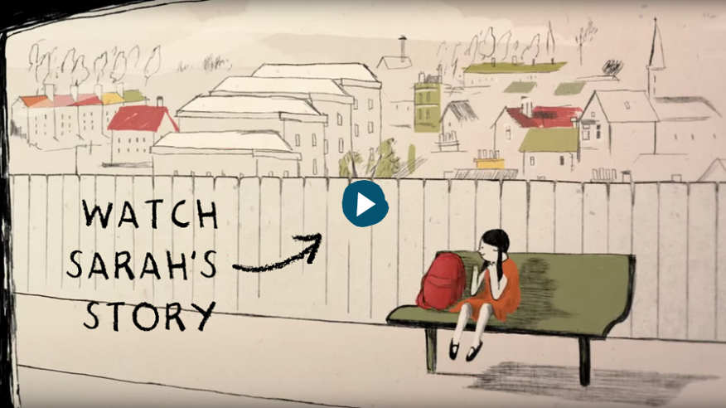
Sexual Abuse
Safeguarding Overview | Safeguarding Themes | Reporting Concerns
What is Sexual Abuse?
This involves persuading, enticing or forcing a child or young person to take part in sexual activities.
Men and Women can commit acts of sexual abuse. As can other children and young people.
Contact Abuse – involves physical sexual contact.
It does not necessarily involve a high level of threat of violence and the child or young person may or may not be aware of what is happening.
Non-Contact Abuse – includes online abuse such as viewing inappropriate images.
Contact and Non-Contact Abuse
  Contact Abuse
  Involves unwanted physical sexual contact acts such as kissing, rubbing and touching outside of clothing or masturbation, oral sex or rape.
  Involves act Non-Contact Abuse.
  Activities such as showing inappropriate sexual images to children and young people, taking or sharing sexual images of children, making them watch sexual acts, encouraging children to behave in sexually inappropriate ways and grooming a child or young person in preparation for abuse.
7
Notes:
Facilitator instructions and explanation: Discussion of this issue will be guided by the age/maturity and ability of students.
Students will need to have an understanding of language / terminology relating to this topic. Before showing this slide ask students what they consider sexual abuse to be. Brainstorm ideas. Watch the video. From this language and concepts can then be explored.
Participant discussion: (relating to the VIDEO)
What is sexual harassment?
What kind of comments of a sexual and personal nature might be considered sexual harassment? Does this constitute sexual abuse? How does sexual harassment differ from what Sarah describes in the video clip?
Does it just happen to people over the age of 18?
Does it depend on your sexuality or your gender?
Additional information for facilitators:
Further discussion or time could be used to examine some of the recent stories shared in the news or media. Stories of people or victims ‘speaking out’. You may want to discuss how some high profile people have made a stance against sexual harassment and link it to the rights of women and raise awareness of International Women’s Day in March.
Video/audio clip:
‘Watch Sarah’s Story’ – A short animation narrated by Sarah who was a victim of sexual abuse as a child when a family friend moved into the family home. Sarah shares her experiences and how ChildLine enabled her to move forward with her life.
The clip can be used to highlight and inform that children and young people may disclose abuse at any age, in some cases many years after the sexual abuse took place. The facilitator can use the opportunity to reinforce the idea that it is never too late to disclose or seek advice and support for any form of abuse.

Slide 8
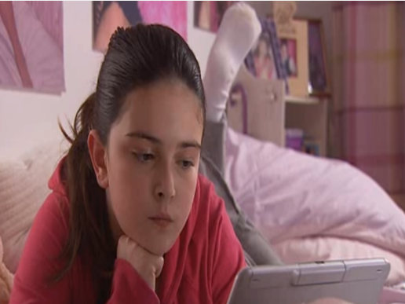



Child Sexual Exploitation (CSE)
What is Safeguarding? | Safeguarding Themes | Get Help
Child Sexual Exploitation (CSE) is a form of child abuse
It can happen to anyone who is persuaded, bullied or forced into having sex or sexual activity such as taking and sharing naked photos of themselves
This can be in return for things like alcohol, money, drugs or other gifts
It can happen online and face to face
What is Child Sexual Exploitation?
It ruins lives and has serious long-term effects on young people and their families
  The film Jigsaw is a story about a young girl called Becky who likes to use online social media to shares information and photos of herself and her friends. Becky has been talking to somebody who she believes to be another child. It turns out to be a man who has lied to her.
Get Help
  There are people who know how to help children and young people in this situation.
  They will believe you. There is a way out.
  Ring the Police on 101
  If you are not ready to report something you can speak to a trusted adult
  or ChildLine 0800 1111
8
Notes:
Facilitator instructions and explanation:
Some students will think that it is easy to ‘just say no’ (in terms of persuasion). It is important to recognise that all forms of exploitation are fuelled by power, control, circumstances and erosion of a victim’s self worth and esteem, thereby making it hard to simply ‘just say no’.
The link to ‘Think U Know’ logo will take you directly to the CEOP (Child Exploitation and Online Protection) site for children and young people.
Reinforce the idea that help and support is available from lots of sources, however the Police have dedicated teams to address reports of CSE.
Participant discussion:
Explore what persuaded, bullied, or forced might look like (including power and control). What examples can be given? How are they similar and what are the differences? Do they hold equal weight?
What do pupils think serious long term effects could be? (e.g. future relationships, their own individual wellbeing, self esteem, family, social life, education, aspirations etc.)
Who is a trusted adult, what makes them trusted? Can pupils give examples of who they may be?
Additional information for facilitators:
Facilitator can refer back to slide 7 on sexual abuse - to explore what sex or sexual activity might include.
Participant reflection: The earlier discussion can be expanded and the following are further points for reflection / consideration.
Do you think this is something that could happen or does happen at your age?
This clip showed it happening to a girl, could this happen to a boy?
How could you prevent this happening to you or one of your friends?
How can we keep in touch with our friends in a safe way?
Can we create three top tips for us all to remember?
Can we watch the video once again and discuss the levels of risk, what was high risk and why? (The facilitator could provide laminated cards with the levels of risk printed on to hold up in the class to aid the discussion).
Video/audio clip- See slide for a description of the video. Also consider using these:
Kayleigh’s Love Story – (rated 15) This is a five minute film about aspects of the last 13 days of the life of 15-year-old Kayleigh Haywood. In November 2015, she was groomed online by Luke Harlow, a man she had never met, before being raped and murdered by his next door neighbour Stephen Beadman. http://www.youtube.com/watch?v=WsbYHI-rZOE LINK????
The Story of Jay – a two minute animation. This video was developed with young people as part of the NSPCC Protect and Respect Service. Sometimes relationships aren't what they seem. Can you see the signs that something isn't right in this relationship? Would you know what to do if this were happening to you, or your friend? Please note: This video contains scenes of a sexual nature and depiction of drug use. http://www.youtube.com/watch?v=w6vYbZSUL5U.

Slide 9
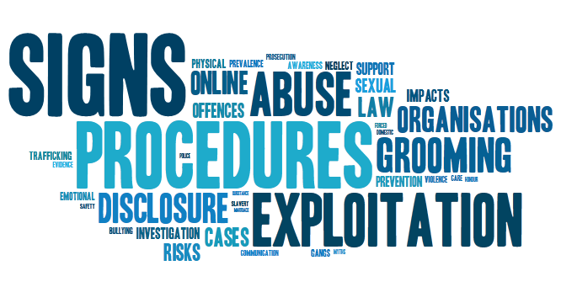
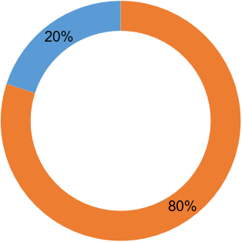


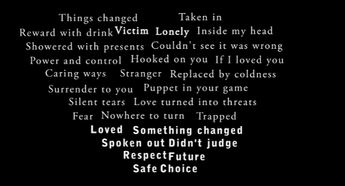
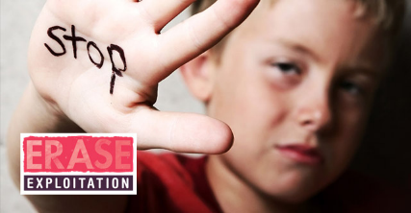

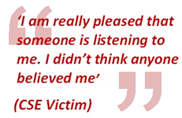
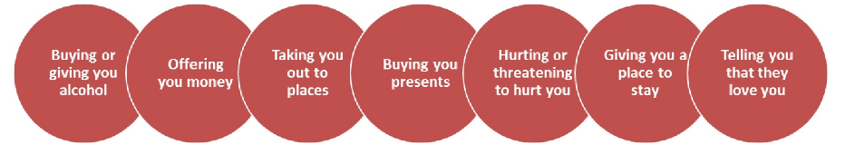
Child Sexual Exploitation (CSE)
What is Safeguarding | Safeguarding Themes | Get Help
  The video below is a local victim’s experience of being exploited.
Child Sexual Exploitation
Online Grooming is the most common model
Of those young people targeted 80% are girls
The average age of victims is 12 yrs old
In school sessions you told us that these were some of the things that people use to manipulate a young person in to sexual activity
9
Notes:
Facilitator instructions and explanation:
This slide provides information on basic data relating to Child Sexual Exploitation (CSE) and grooming. It is important to stress that although girls are predominantly the victims. It happens to boys too.
Emphasise the circles as these have been generated by young people themselves.
There are links that will take you directly to relevant sources of further information on CSE including:
The SIGNS word image will take you directly to the Durham LSCB web page.
The ERASE link will take you directly to the Durham and Darlington CSE webpage hosted by the police.
Participant discussion:
Discuss key points from the video. Explore pupils feelings and thoughts about what they have seen / heard.
Ask the students to focus on the circles. Can they identify other ways people might use to manipulate a young person into sexual activity?
Additional information for facilitators:
The facilitator will need to remind the students about their group agreement, as the audio clip may cause some strong emotional responses.
Video/audio clip:
‘Its abuse’ – A poem by a victim of CSE. The audio clip highlights the main stages of the grooming process and how the victim felt towards her abuser at each stage. This can give students an insight into CSE and help them process and understand how it may begin.

Slide 10
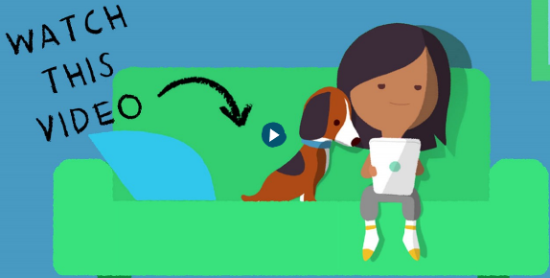
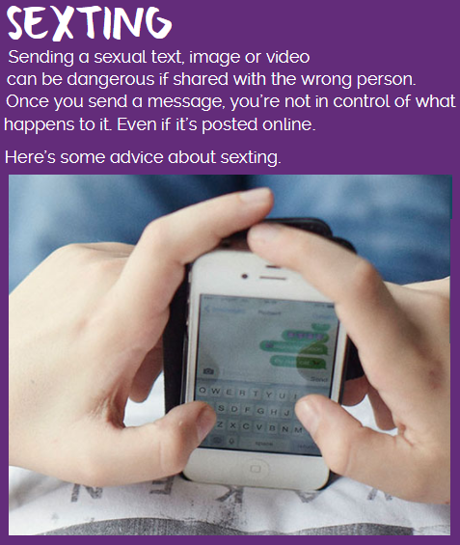
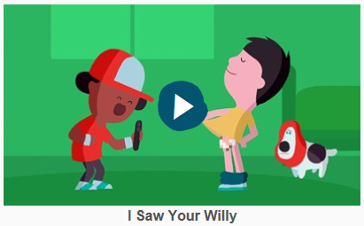
‘Nudes’ (or sexting)
What is Safeguarding? | Safeguarding Themes | Get Help
What are Nudes?
Nudes are when someone shares sexual, naked or semi-naked images or clips of themselves or others, or sends sexually explicit messages.
The sender has no control about how they are shared, you may think sending nudes is harmless but it can leave you vulnerable to blackmail, bullying, unwanted attention and emotional distress.
When you’re under 18 it’s against the law for anyone to take, share or have a sexual photo of you – even if it’s a selfie.
Get Help
  The sooner you talk to somebody about the situation the better. This could be your mum, dad, carer or a teacher. They will help you deal with this.
Be share aware
10
Notes:
Facilitator instructions and explanation:
The concept of ‘sender’ needs to be explored. This can be the individual who took the image and sent it, or another who has received it and then passed the images on (both off and online).
The taking of ‘selfies’ and the sharing of these through a variety of ways has changed over time. Photos (including revealing / explicit images) may be ‘widely shared’ without the owners consent. Explore where images can end up (with or without the owners consent) and the impact that this could have.
Take time to explore ‘the law’ relating to this issue. https://www.childline.org.uk/info-advice/bullying-abuse-safety/online-mobile-safety/sexting/. The purple sexting link on the slide takes you too the ChildLine page where sexting and the law is explored in depth.
Participant discussion:
What are the ‘rights’ of the person in a photograph. Are they able to claim these rights? What steps can individuals take to protect their privacy e.g. action / laws etc?
What advice can you give to individuals / others to help them protect their privacy?
Video/audio clip:
Be Share Aware produced by NSPCC and O2. – safety advice from a 10 year old. Teach your child to Be Share Aware. Sharing in real life is great but children need our help to stay safe online. NSPCC and O2 can help with step-by-step advice. Find out more here: http://bit.ly/2qXL0IF
‘I saw your willy’ - NSPCC and O2 animation to highlight the consequences of taking and sharing images to others. Asking parents to be Share Aware in regard to online safety.

Slide 11
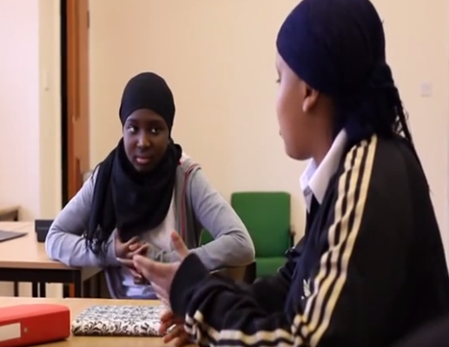

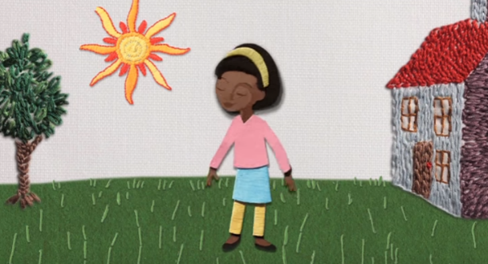

Female Genital Mutilation (FGM)
What is Safeguarding? | Safeguarding Themes | Get Help
‘Think Again’ is a short film with girls talking about FGM and their worries this will happen to their friend.
What is Female Genital Mutilation?
Female Genital Mutilation is sometimes called FGM, female genital cutting or just cutting and female circumcision.
Girls of school age may be taken abroad at the start of holidays, giving them sufficient time for them to recover before returning to their studies.
FGM is a form of child abuse.
FGM can occur at any age, from birth to marriage and beyond.
'My Body My Rules' is a three minute animated film aimed at raising awareness of female genital mutilation (FGM) amongst primary school aged children.
Get Help
FGM has been a criminal offence in the UK since 1985. Care professionals and teachers in England and Wales must report ‘known’ cases of FGM in under 18s.
If you have any concerns, talk to an adult you trust.
11
Notes:
Facilitator instructions and explanation:
The film ‘Think Again’ contains descriptions of Female Genital Mutilation (FGM). Some students may find it upsetting to hear young women discussing this. Students should be reminded of their group agreement and their right to ’opt out’ if necessary.
Although FGM is illegal in the UK, the practice still happens to UK children and usually performed overseas. Some girls may be aware that this practice will happen to them and be told that it is in their best interests and a ‘right of passage’ to womanhood. Other girls will be forced to undergo this procedure against their will. Almost all have no concept of what happens and the implications of it. Countries where FGM takes place include Egypt, Somalia, Ethiopia (but these are not the only ones and it can relate to cultural practice).
It is important to help students understand that although illegal in this country it still happens or has happened to girls attending UK schools (including students in County Durham!)
Statistics / numbers may be low in the local area because of cultural and ethnic diversity, but this should not detract from the fact that this is a significant issue within safeguarding.
The focus is on broadening everyone’s understanding of FGM; the signs and symptoms, that it is illegal practice and where individuals can go for help, advice and support.
Participant discussion:
If this practice is illegal in the UK why should we be concerned with it? (known and unknown cases).
Why do you think teachers and care professionals must report ‘known’ cases?
Additional information for facilitators:
Local charity the Angelou Centre based in Newcastle work to raise awareness of FGM. They also support girls and women directly affected by FGM. http://angelou-centre.org.uk/
Forwarduk charity also provide similar services. http://forwarduk.org.uk
Video/audio clips:
'My Body My Rules‘ (forwarduk 2015) is a three minute animated film aimed at raising awareness of Female Genital Mutilation (FGM) amongst primary school aged children in the UK.
"Think Again“ is a thought-provoking film that follows a 12-year-old's struggle between family honour and the facts about FGM. On discovering that her mum wants to take her back home to be 'cut' she explores the implications FGM might have on her life. The film also covers misconceptions and explains why the practice persists in the 21st century.

Slide 12

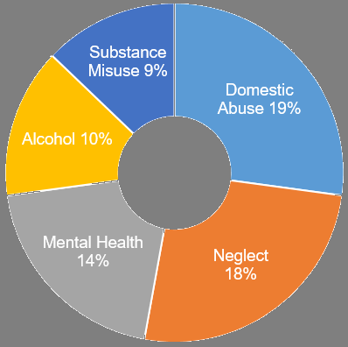
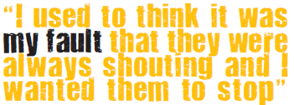
Domestic Abuse
What is Safeguarding? | Safeguarding Themes | Get Help
What is Domestic Abuse?
Some parents or adults in families can hurt, hit or bully other adults or children.
Domestic abuse includes emotional, physical, sexual, financial or psychological abuse.
Domestic abuse can seriously harm children and young people. Witnessing domestic abuse is child abuse.
Teenagers can suffer domestic abuse in their relationships.
Domestic Abuse is the main parental risk factor leading to children becoming subject of a Child Protection Plan
Get help
Domestic Abuse is not the fault of children in the home. Harbour can help young people deal with the affects of witnessing domestic abuse through individual support.
12
Notes:
Facilitator instructions and explanation:
The Police across County Durham and Darlington are called out to approximately 12,000 domestic abuse incidents per year. Many of these are witnessed by, or involve children and young people. The facilitator will need to explore the different aspects of domestic abuse (emotional, physical, sexual, financial and psychological).
Participant discussion:
Witnessing domestic abuse is not only about ‘seeing it or being immediately involved’. It includes hearing what is going on. How might this affect the children or young people involved?
Teenage abusive relationships are often not considered by young people as domestic abuse. What if any, are the differences between teenage abusive relationships and adult abusive relationships? How can young people help others to understand what is ‘acceptable’ and ‘not acceptable’ in a relationship or friendship?
Why do you think so many children and young people become subject to a child protection plan as a result of domestic abuse?
Additional information for facilitators:
There are two links to Harbour (domestic abuse support service) on this slide. The link in the quote at the bottom right covers issues relating to children affected by domestic abuse. The other is the Harbour logo, which is a direct link to their support service.
Participant reflection:
Students should be given some time to consider individually who they would talk to if they, their carers or a friend are victims or witness domestic abuse.

Slide 13
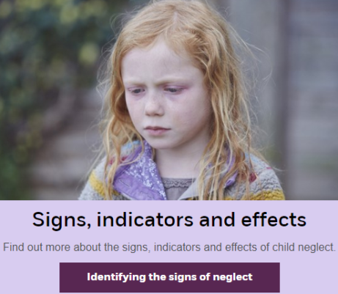
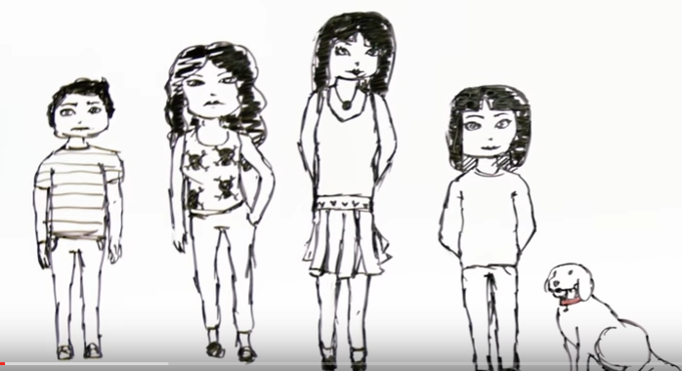
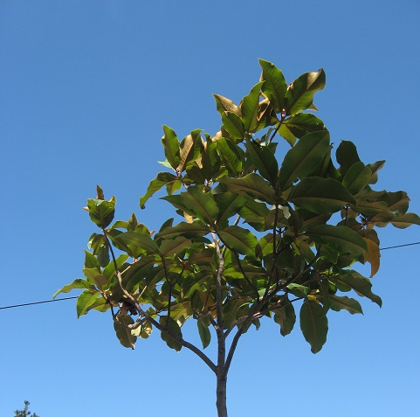

Neglect
What is Safeguarding? | Safeguarding Themes | Get Help
Neglect Video: Michelle's Story
What is Neglect?
Child neglect is a failure to look after a child and could result in poor health or development.
Children (including unborn babies), need food, water, shelter, warmth, protection and health care to grow and develop.
Children need their parents or carers to love and care for them.
Neglect can also include physical abuse, emotional abuse and sexual abuse.
This tree received very little care or water;
the people
close by
had
no
interest
In this
tree
  Two identical trees can provide a visual example of nurturing or neglect.
People by this tree looked after it, watered
and cared
for it
  The outcome is strikingly different, isn't it?
  The neglected tree is struggling, the tree that received care and attention is thriving.
13
Notes:
Facilitator instructions and explanation:
Before clicking on link (child top centre) explore the questions below.
Participant discussion:
What do you consider a nurturing and caring environment is - for a child to thrive or grow up in?
What practical examples can you give to show your understanding?
What might be the impact of not having been cared for?
Can you think of any other analogies (other than the tree) to describe neglect?
Does neglect always happen as a result of poor parenting /caring. Can it happen in any other situation? (consider issues such as malnutrition as a result of drought / famine, fleeing war torn areas, families that are homeless etc.)
Additional information for facilitators:
The facilitator should be mindful that ‘Michelle’s story’ may raise questions about young carers and their role. Some young people take on a caring role for a parent/carer who misuses drugs or alcohol. Facilitate discussion about when a young person may become ‘at risk’. Please take into consideration there may be a young person (known or unknown) in the session that currently has caring responsibilities.
It might be helpful to share with students the definition of a young carer. A young carer is someone aged 18 or under who helps look after a relative who has a condition, such as a disability, illness, mental health condition, or a drug or alcohol problem. ‘Being a young carer your rights’ (NHS). For further information go to: https://www.nhs.uk/conditions/social-care-and-support/young-carers-rights
Video/audio clip:
Michelle’s Story: This is the story of Michelle and her experience of neglect as she was growing up. For more information about child neglect, please visit the LSCB website at www.rbkc.gov.uk/lscbneglectcampaign or the NSPCC at www.nspcc.org.uk

Slide 14
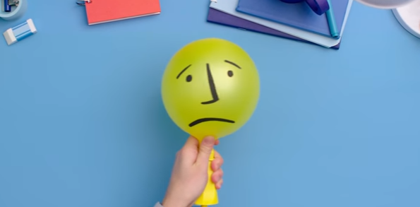


Neglect
What is Safeguarding? | Safeguarding Themes | Get Help
Get Help
When I first met you I knew I could trust you; everything in my life changed, you helped me understand more about the situation I lived in and helped organise extra support for me to cope. I’ve laughed and cried, thank you for listening to me and reminding me how to stay on the right track and for being my guardian angel ☺ ☺
SB 15yrs old
  Every child and young person has the right to be looked after properly. If you’re not getting the important things you need at home, you could be being neglected.
  If you are not ready to report something you can speak to ChildLine 0800 1111
  Watch the video to see what happens when you contact ChildLine
14
Notes:
Facilitator instructions and explanation:
Children have the right to be looked after properly. This could be linked to work on Rights Respecting Award criteria (United Nations Convention of the Rights of the Child). https://www.unicef.org.uk
Participant discussion:
What rights do children have? How easy are they to be claimed? Are you aware of any countries that do not sign up to the UN Convention of the Rights of the Child? Why might this be the case?
How is the voice of the child heard? What ways can you think of that ensures children feel they have a voice?
Participant reflection:
It is important to help students reflect on who they would go to for help.
Video/audio clip:
This video takes the viewer through the steps that are taken when a child rings ChildLine.

Slide 15
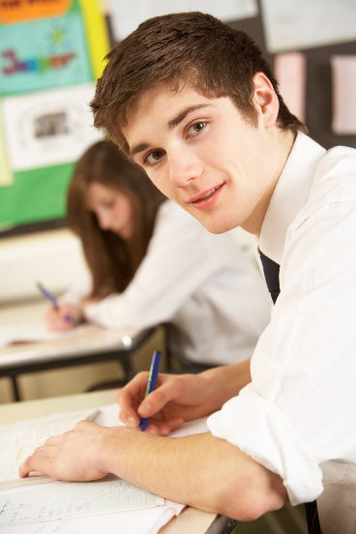

Supporting Young People
What is Safeguarding? | Safeguarding Themes | Get Help
What can you do to help your friends and other children and young people?
If you are worried about someone, it can help to talk about it. – Try and talk to your friend and ask them to tell you what is wrong. It might be hard for them to say, especially if they are scared or worried about what might happen. If they don’t want to talk to you, suggest that they talk to an adult you both trust.
If you think your friend might be in danger or are really worried about them, you should tell an adult you trust. It’s hard to support your friends alone if their problems are serious.
If someone is hurting you talk to an adult who you trust – this may be
somebody in your family
school nurse
school teacher
police officer
Childline
If you are under 18 years old you are called a child, or a teenager under the Children Act 1989. This means that you are protected in law from actions or behaviours of anybody who may seek to harm you in any way. As we’ve seen in this document, this may be physical, sexual or emotional harm, which includes bullying. It may be harm that happens as a result of being neglected, domestic abuse or female genital mutilation.
15
Notes:
Facilitator instructions and explanation:
Durham Local Safeguarding Children Board (LSCB) has key priorities for future work. One priority is ‘Increasing the Voice of the Child’
Participant discussion:
Some children / young people feel that if they ‘tell’ on a friend they may lose that person’s friendship. How can children and young people demonstrate that ‘telling’ is really about looking out for and caring for someone?
Participant reflection:
Who would you go to, if you needed to help a friend?

Slide 16









Get Help
What is Safeguarding? | Safeguarding Themes | Get Help
For consultation and all enquiries please contact: Telephone: 0345 155 1071
16
Notes:
Facilitator instructions and explanation:
All of the logos have a link to the organisation shown. Please familiarise yourself with these and ensure that you have an understanding of their services and areas of work. Model this by clicking on some of the logos during discussion – or ask students to find out more about each one.

Slide 17

Our Vision: Every child and young person in Dartmoor Multi Academy Trust schools and colleges feels safe and grows up safe from harm
Acknowledgement
This PowerPoint presentation has been adapted from materials collated by Durham Local Safeguarding Children's Board. We are very grateful for their permission to replicate.
17
Notes:
Facilitator instructions and explanation:
Reinforce the idea that safeguarding is everyone’s responsibility whether student / friend or adult.
The facilitator might need to spend time exploring the concepts of keeping children and young people safe and protecting them from harm.
Participant discussion:
Can students give other examples of services / organisations or individuals whose duty it is to keep children and young people safe? (e.g. youth clubs, scouts, football clubs, dance groups, private tutors, counsellors, school crossing patrol etc.)
What does ‘protecting them from harm’ mean?
What is a safe environment?
Additional information for facilitators:
Facilitators may want to show the LSCB website for further information on their function and role www.durham-lscb.org.uk (see link at top of each slide).

Slide 18
Instructions for Facilitators
   Facilitator instructions and explanation
  Any part of the session where the facilitator needs to explain or model a key concept, theory or strategy, or where the facilitator needs to introduce a learning opportunity / activity. Facilitator instructions also include notes of caution.
   Participant discussion
  Any part of the session where participants need to discuss a topic either in pairs, small groups or as a whole group. Ensure you provide clear discussion prompts to scaffold discussion, and also consider any difficult questions that may be posed by participants during the course of a whole-group discussion, with suggestions as to how these might be answered.
  Be explicit about the purpose of the discussion and any key themes that the facilitator may need to draw out. For example, the purpose of a discussion may be to explore participants’ existing knowledge, beliefs and values.

Slide 19
Additional information for facilitators
Covers any additional information or context that may be helpful for facilitators. This may be a link to a website or resources providing additional detail on the issue covered.
Participant reflection
Any part of the session where participants need to reflect on the content covered. It may be an opportunity for them to critically engage with the information presented. Or, it might be a chance for them to consider what else they might want to cover / address / know. Reflection activities should focus on building in opportunities for formative assessment, where participants evaluate the impact of their learning. A learning log could be used to support this reflection.
Video/audio clip
  Any part of a session supported by either a video or audio clip.
  Video and audio can be used to explain complex topic areas or to use as a distancing technique. Videos in this presentation have all been produced by reputable agencies and are located on external sites. Please ensure all links work (you may need to contact your IT network manager should you need to arrange access).

